Slide 2
Promoting Value In Critical Care By Implementing (Next Five) Choosing Wisely® For Critical Care
Jerry J. Zimmerman, MD, PhD, FCCM
Faculty, Pediatric Critical Care Medicine
Seattle Children’s Hospital, Harborview Medical Center
University of Washington School of Medicine
Seattle, WA

Slide 3
Disclosures for Jerry J Zimmerman
Research funding from NIH and Immunexpress
Royalties from Elsevier for co-editing, Pediatric Critical Care

Slide 4
Promoting Value In Critical Care By Implementing (Next Five) Choosing Wisely® For Critical Care
Acknowledge that reducing waste represents a key element in optimizing critical care quality and value.
Review the original Choosing Wisely® For Critical Care.
Summarize the Next Five Choosing Wisely® For Critical Care.
Appreciate the important relationships of Choosing Wisely® For Critical Care and the ICU Liberation A-F Bundle.

Slide 5
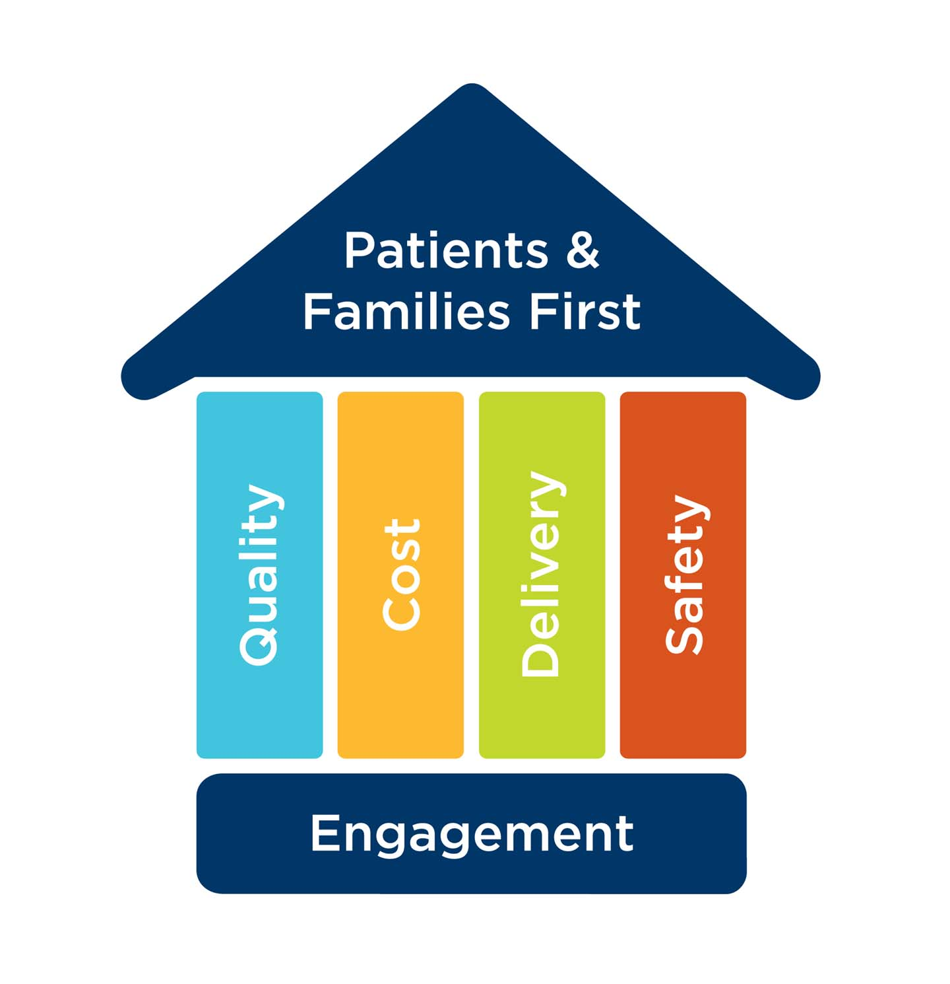
Informed
And Engaged
Interdisciplinary Staff
Construction of a house of value within the intensive care unit . . .
Quality
Cost
Delivery
Safety
Patients and Families First

Slide 6
Just because we can, doesn’t mean we should.
Value in the context of medical care has been characterized as improving outcomes that matter to patients relative to the cost of achieving those outcomes.
Porter ME, Lee TH: The strategy that will fix health care. Harvard Business Rev 2013; 91:50–70.

Slide 7
Overuse, A Very Real, Underappreciated Patient Safety Issue . . .
An estimated one-third of care delivered in
the United States is considered wasteful.
Institute of Medicine.
Best Care at Lower Cost: The Path to Continuously Learning Health Care in America.
Washington, DC: National Academies Press; 2012.
Financial harm
Physical harm
Emotional harm
Fisher ES, et al. JAMA. 1999;281(5):446-453.
Berwick DM, Hackbarth AD. JAMA 2012;307:1513-1516.
Moriates C, et al JAMA. 2013;310(6):577-578.

Slide 8
“As evidence increases about the harms from health care overuse, physicians have a professional obligation to reduce these events on both an individual patient level and across health care systems”.
“Overuse may need to be considered equal to adverse events and reviewed in the same context”.
Zapata JA, et al. JAMA 2017; 317 (8): 849-850.

Slide 9
Complex
Patient
Complex
Therapy
Complex
Environment

Slide 10
The Background Science of Choosing Wisely®
Overcoming Therapeutic Illusion
Providers and patients are constantly looking for an exact and immediate medical answer.
Care providers may assume that families and referring physicians expect them to always, “just do something”.
Some practitioners equate multiple tests and therapies with being thorough or caring.
Reassurance or “watching and waiting” may be viewed with disinterest or not doing enough.
Casarett D. N Engl J Med 2016; 374: 1203-1205.

Slide 11
The Background Science of Choosing Wisely®
Overcoming Therapeutic Illusion
New technology and therapies always appear promising and attractive.
Providers may be uncomfortable with “medical uncertainty”. This situation may foster defensive medicine because of concerns about the risks of litigation.
Health care systems may incentivize more testing and care than may actually be necessary.
Lack of continuity may result in the substitution of excessive
testing in place of a thorough assessment.
Casarett D. N Engl J Med 2016; 374: 1203-1205.

Slide 12
Brody H. N Engl J Med 2010; 362:283-285. Cassel CK, et al. JAMA 2012; 307:1801-1802.

Slide 13
Choosing Wisely® in the ICU
Top five list for critical care medicine
Developed by the Critical Care Societies Collaborative
Included nursing perspective
Reflected 150,000 members at the time
http://www.choosingwisely.org/societies/critical-care-societies-collaborative-critical-care/

Slide 14
Choosing Wisely® for Critical Care
Five things that physicians
and patients should question
Angus DC, Deutschman CS, Hall JB, et al. Crit Care Med 2014; 42(11):2437-2438.
Halpern SD, Becker D, Curtis JR, et al. Am J Respir Crit Care Med 2014; 190(7):818-826.

Slide 15
Choosing Wisely® for Critical Care
Angus DC, Deutschman CS, Hall JB, et al. Crit Care Med 2014; 42(11):2437-2438.
Halpern SD, Becker D, Curtis JR, et al. Am J Respir Crit Care Med 2014; 190(7):818-826.

Slide 16
Choosing Wisely® for Critical Care
Angus DC, Deutschman CS, Hall JB, et al. Crit Care Med 2014; 42(11):2437-2438.
Halpern SD, Becker D, Curtis JR, et al. Am J Respir Crit Care Med 2014; 190(7):818-826.

Slide 17
Choosing Wisely® for Critical Care
Angus DC, Deutschman CS, Hall JB, et al. Crit Care Med 2014; 42(11):2437-2438.
Halpern SD, Becker D, Curtis JR, et al. Am J Respir Crit Care Med 2014; 190(7):818-826.

Slide 18
Choosing Wisely® for Critical Care
Angus DC, Deutschman CS, Hall JB, et al. Crit Care Med 2014; 42(11):2437-2438.
Halpern SD, Becker D, Curtis JR, et al. Am J Respir Crit Care Med 2014; 190(7):818-826.

Slide 19
Choosing Wisely® for Critical Care
Angus DC, Deutschman CS, Hall JB, et al. Crit Care Med 2014; 42(11):2437-2438.
Halpern SD, Becker D, Curtis JR, et al. Am J Respir Crit Care Med 2014; 190(7):818-826.

Slide 20
Next Five Choosing Wisely® For Critical Care
Literature Assessment and Recommendation Ranking Criteria
Patient safety and quality of care
Strength of supporting evidence
Potential improvement in patient outcomes

Slide 21
Next Five Choosing Wisely® For Critical Care
Phases of Taskforce Activity
Phase 1. Conducted individual literature reviews and generated 13 practice statements for group evaluation.
Phase 2. Reduced the list of practices to eight using an
importance ranking system reliant on the strength of evidence
and potential impact on patient care.
Surveyed SCCM member to further decrease the top eight
recommendations down to five.
Phase 3. Reviewed the membership survey recommendations and finalized importance rank scoring. Received approval by SCCM Executive Committee and Council and ABIM

Slide 22
Next Five Choosing Wisely® for Critical Care
additional
Five things that physicians
and patients should question
V
Zimmerman JJ.; Harmon LA, Smithburger P, Crit Care Med 2021; 49 (3):
https://www.choosingwisely.org/societies/society-of-critical-care-medicine/

Slide 23
Zimmerman JJ.; Harmon LA, Smithburger P, Crit Care Med 2021; 49 (3):
https://www.choosingwisely.org/societies/society-of-critical-care-medicine/

Slide 24
Next Five Choosing Wisely® for Critical Care
Patients in intensive care units typically require insertion of catheters and drains for fluid and medication delivery, pressure and flow monitoring, and fluid and gas evacuation. The majority of hospital-acquired infections and unintended safety events are associated with such devices. Daily assessment for need of invasive devices should be an essential element of critical care workflow, to reduced time of exposure by identifying the earliest opportunity for their discontinuation.
Zimmerman JJ.; Harmon LA, Smithburger P, Crit Care Med 2021; 49 (3):
https://www.choosingwisely.org/societies/society-of-critical-care-medicine/

Slide 25
Urinary Bladder Catheters
Minimize urinary catheter use and duration of use in all patients, particularly those at higher risk for CAUTI or mortality from catheterization such as women, the elderly, and patients with impaired immunity.
For operative patients who have an indication for an indwelling catheter, remove the catheter as soon as possible postoperatively, preferably within 24 hours, unless there are appropriate indications for continued use.
https://www.cdc.gov/infectioncontrol/guidelines/cauti/

Slide 26
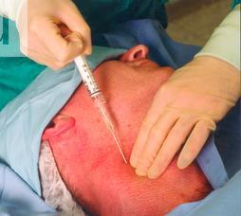
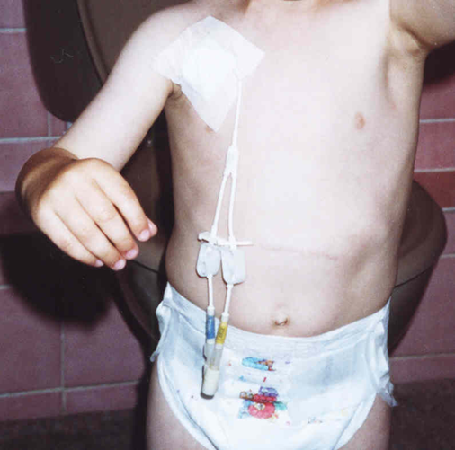
Central Line Associated Blood Stream Infections

Slide 27
Clinical Consequences of CLABSI
Increased length of stay
Need for prolonged antibiotic therapy
Need for ongoing venous access
Increased morbidity and mortality
Increased costs of health care
Nowak JE, Brilli RJ, Lake MR, et al.
Reducing catheter-associated bloodstream infections in the pediatric intensive care unit:
Business case for quality improvement.
Pediatr Crit Care Med 2010; 11 (5): 579-587.

Slide 28
Central Line Associated Blood Stream Infections: Longitudinal Trends and Compliance With CLABSI Bundle Strategies Among USA PICUs
5.8 ± 2.9 [4.5, 7.1]
Insertion Bundle
Maintenance Bundle
3.8 ± 3.1 [2.7, 4.9]
CLABSI Rate / 1000 CVC Days
1.4 ± 1.2 [1.2, 1.6]
Edwards JD, et al. Am J Infect Control 2015; 43 (5): 4889-493.

Slide 29
Clinical Standard Work For Central Venous Catheters
Use appropriate hand hygiene.
Use chlorhexidine for skin preparation.
Use full-barrier precautions during CVC insertion.
Avoid using the femoral vein for catheters in adult patients.
Remove unnecessary catheters.
https://www.ahrq.gov/hai/clabsi-tools/appendix-3.html#sl10

Slide 30
Multiple Strategies to Reduce CABSI in the PICU
Antibiotic
Impregnated Catheters
Catheter
Insertion Bundles
Catheter Maintenance Bundles
CLABSI
Standardize Catheter
Practice
Limit the Access of
Catheters
Remove Unnecessary Catheters
Decrease Laboratory
Studies
Conduct
Event
Reviews

Slide 31
SHEA Supports A Similar Recommendation
Society of Healthcare Epidemiology of America endorsed a
a similar Choosing Wisely® recommendation:
“Avoid invasive devices (including central venous catheters,
endotracheal tubes, and urinary catheters) and, if required,
use them no longer than necessary. They pose a major risk for
infection”.
Morgan DJ, Croft LD, Deloney V, et al. Infect Control Hosp Epidemiol 2016; 37 (7): 755-760.

Slide 32
Next Five Choosing Wisely® for Critical Care
Although mechanical ventilation is frequently lifesaving, it is also associated with numerous complications. Discontinuation of mechanical ventilation support is frequently the rate limiting step in ICU discharge. Current guidelines recommend removing patients from mechanical ventilation support as soon as possible utilizing mechanical ventilation liberation and sedation interruption protocols in concert with structured multidisciplinary rounds.
Zimmerman JJ.; Harmon LA, Smithburger P, Crit Care Med 2021; 49 (3):
https://www.choosingwisely.org/societies/society-of-critical-care-medicine/

Slide 33
A Respiratory Therapist-Driven Pathway Improves Timeliness Of Extubation Readiness Assessment
A respiratory therapist-driven extubation readiness test pathway can be safely implemented in a large, academic PICU.
The pathway resulted in earlier extubation readiness testing without increasing key balancing measures—the duration of mechanical ventilation, PICU length of stay, or the extubation failure rate.
Loberger JM, et al. Pediatr Crit Care Med 2020; 21: e513–e521.

Slide 34
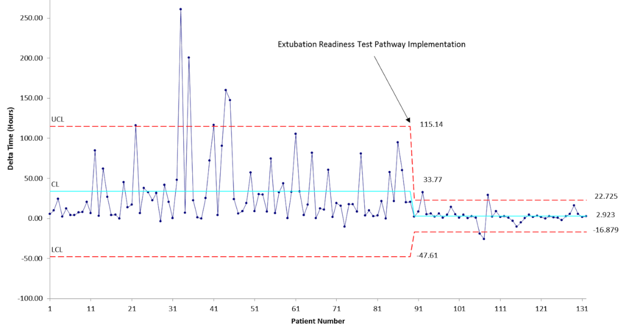
*Difference between when a subject met ERT eligibility criteria and the start of the first ERT.
Extubation Readiness Test Pathway Implementation
Delta Time* (Hours)
Patient Number

Slide 35
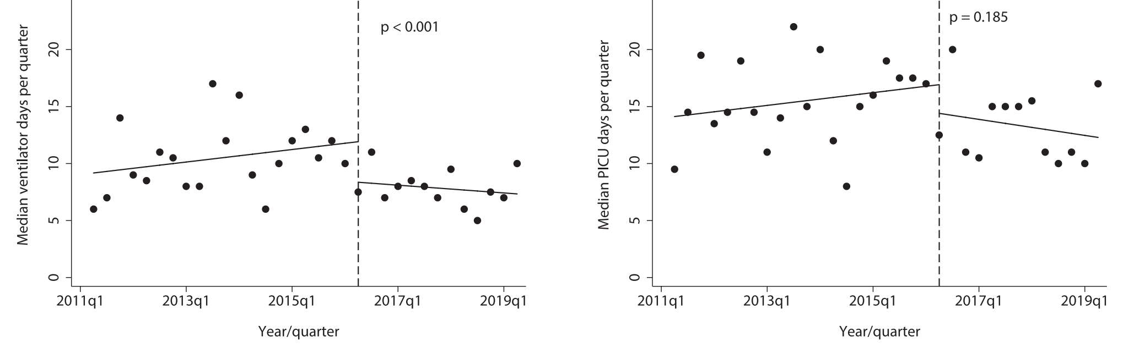
Ventilator-Weaning Pathway Associated With Decreased Ventilator Days in PARDS
p < 0.001
p = 0.185
Median MV D/Quarter
0 5 10 15 20
Median PICU D/Quarter
0 5 10 15 20
2013 2015 2017 2019
Year (Quarter 1)
2013 2015 2017 2019
Year (Quarter 1)
Mehta SD, et al. Pediatr Crit Care Med 2021; 49 (2): 302-310.

Slide 36
Ventilator-Weaning Pathway Associated With Decreased Ventilator Days in PARDS
Sanjiv D. Mehta SD, et al. Pediatr Crit Care Med 2021; 49 (2): 302-310.

Slide 37
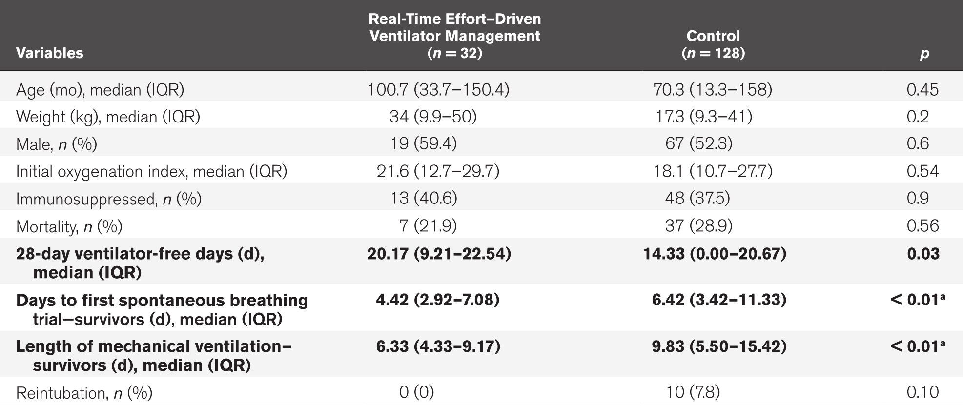
Real-Time Effort Driven Ventilator Management
Hotz JC, et al. Pediatr Crit Care Med 2020; 21 (11): 933–940.

Slide 38
Protocolized Versus Non-protocolized Mechanical Ventilator Weaning For Critically Ill Children: Systematic Review
Three trials at low risk of bias with 321 children analyzed.
Protocolized weaning significantly reduced total ventilation time in the largest trial (260 children) by a mean of 32 hours [95% CI 8-56; p = 0.01].
Two other trials (30 and 31 children, respectively) reported non-significant reductions with a mean difference of -88 hours [95% CI -228-52; p = 0.2] and -24 hours [95% CI -10-58; p = 0.06].
Protocolized weaning significantly reduced weaning time in these two smaller trials for a mean reduction of 106 hours [95% CI 28-184; p = 0.007] and 21 hours [95% CI 9-32; p < 0.001].
Blackwood B, et al. Cochrane Database Syst Rev 2013; 7: CD009082

Slide 39
Factors That Impact On The Use Of Mechanical Ventilation Weaning Protocols
Continuing staff training and development
Understanding intent and details of the protocol
Identifying a champion for the protocol
Implementing evidence-based best practice
Expanding clinical experience→competence/confidence
Ensuring adequate stakeholder buy-in
Knowing nursing/RT scope of practice; professional liability
Recognizing ICU structure and processes of care
Enhancing visibility and ease of implementation
Utilizing protocols to facilitate consistent communication
Sharing successes with clinically meaningful metrics.
Sustaining continuous process improvement.
Jordan J, et al. Cochrane Database Syst Rev 2016; 10 (10): CD011812.

Slide 40
SCCM ICU Liberation A-F Bundle
Ely EW. Crit Care Med 2017; 45 (2): 321-330.

Slide 41
Next Five Choosing Wisely® for Critical Care
In addition to employing microbe-directed therapy, a core principle of antibiotic stewardship is limiting antimicrobial therapy to the shortest effective duration. As a general rule, antimicrobials should be discontinued when the condition for which they were prescribed has been adequately treated, as one strategy to ensure access to effective antimicrobials, at a time when increased antimicrobial resistance represents a global health care challenge.
Zimmerman JJ.; Harmon LA, Smithburger P, Crit Care Med 2021; 49 (3):
https://www.choosingwisely.org/societies/society-of-critical-care-medicine/

Slide 42
Adverse Effects of Antimicrobials
Antimicrobial resistance
Fungal infections
Drug interactions
Rash, photosensitivity
Allergy, anaphylaxis
Increased health care costs
Acute kidney injury, hepatotoxicity, marrow suppression
Gastrointestinal injury: nausea/vomiting, loss of appetite, alteration of microbiome, injury of GI epithelia, diarrhea, C. difficile colitis
https://www.drugs.com/article/antibiotic-sideeffects-allergies-reactions.html

Slide 43
ANTIBIOTIC RESISTANCE THREATS
IN THE UNITED STATES
More than 2.8 million antibiotic-resistant infections occur in the U.S. annually, and
>35,000 people die as a result. In addition, 223,900 cases of C. difficile occurred in
2017 and >12,800 people died.
2019
www.cdc.gov/
DrugResistance/Biggest-Threats doi.org/10.15620/cdc:82532

Slide 44
Antimicrobial Stewardship Is Crucial for Value-Based Care
Appropriate antimicrobial stewardship that includes optimal selection, dose, and duration of treatment, as well as control of antibiotic use, will prevent or slow the emergence of resistance among microorganisms.
However, 20-50% of all antibiotics prescribed in U.S. acute care hospitals are either unnecessary or inappropriate.
ISDA. Clin Infect Dis 1997; 25 (3): 584-599. Fridkin SK, et al. MMWR 2014; 63.

Slide 45
Leadership commitment: Adequate resources
Accountability: Responsible single leader
Drug expertise: Responsible single pharmacist leader
Action: Implementing at least one recommended action
Tracking: Monitoring antibiotic patterns
Reporting: Regular reporting to relevant staff
Education: Educating clinicians
https://www.cdc.gov/antibiotic-use/healthcare/implementation/core-elements.html

Slide 46
Next Five Choosing Wisely® for Critical Care
Patients can develop significant muscle weakness and atrophy (including the diaphragm) during their ICU stay due to immobilization. However, multidisciplinary facilitated early mobilization has been shown to be safe in the ICU setting. Numerous, patient-centered, clinically meaningful outcomes are supported by early mobilization of critically ill patients.
Zimmerman JJ, Harmon LA, Smithburger P, Crit Care Med 2021; 49 (3):
https://www.choosingwisely.org/societies/society-of-critical-care-medicine/

Slide 47
The Evil Sequelae of Complete Bed Rest
“In most cases the evil effects of complete bed rest are potentiated by anesthesia, narcotics or other medications or by the results of the original illness.
“. . . The effects of hospital life and of bed rest on the psyche are so obvious and have been so clearly described by such novelists as Tolstoi and Balzac that most laymen are well aware of this hazard of therapy.
“. . . The physician must always consider complete bed rest as a highly un-physiologic and definitely hazardous form of therapy, to be ordered only for specific indications and discontinued as early as possible.”
Dock W. JAMA 1944: 125 (16): 1083-1085.

Slide 48
Lean Body Catabolism in Stress States
Corticosteroids,
IL-1, TNF-α, IL-6
Immobilization
Ubiquitin
Proteosome
Pathway
Amino
Acid
Lysis
Gluconeogenesis
Acute Phase Proteins
Immune Cell Expansion
Mitch WE, Goldberg AL. N Engl J Med 1996; 335: 1897-1905.

Slide 49
Why #BedRestIsBad
Brower RG. Crit Care Med 2009; 37(10 Suppl): S422-428.

Slide 50
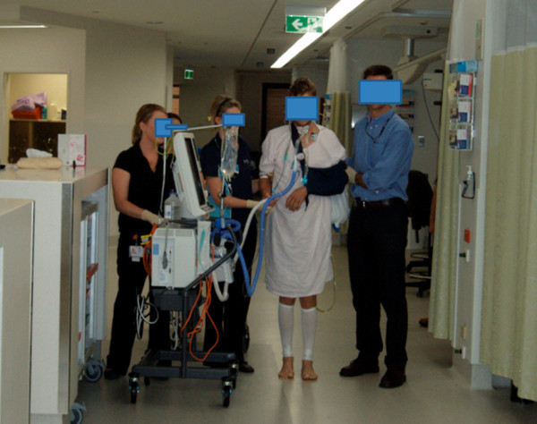
Less Immobilization → Early Mobilization
Less lean body catabolism
Less sedation
Less delirium
Less mechanical ventilation
Less intensive care
Hogdson CL, et al. Crit Care 2013; 28; 17 (1): 207. doi: 10.1186/cc11820.
Schweickert WD, et al. Chest 2011; 140 (6): 1612–1617 .

Slide 51
PICU Up!: Promoting Early Mobilization Among Critically Ill Children
Reflects a multicomponent and interdisciplinary approach to early mobilization of children admitted to the PICU (NCT03860168)
Is feasible and results in no adverse events.
Increases the formal involvement of PTs and OTs
Facilitates early mobilization activities including ambulation
Creates a strong foundation to investigate the effects of early mobilization on functional outcomes in critically ill children
Potentially improves short and long-term outcomes, while providing a healing PICU environment.
Wieczorek B, et al. Pediatr Crit Care Med 2016; 17 (12): e559–e566.

Slide 52
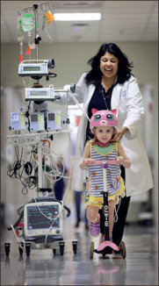
PICU Up!
Early Mobilization Program
“We would talk about patient’s sleeping, but they weren’t; they were intubated and sedated with anesthetic infusions to keep them immobile”
“If our patients woke up, the knee-jerk reaction [was] to give more opiates and benzodiazepines”
“Illness shouldn’t mean stillness”
“We were focusing purely on survival rather than survivorship”.
“Life beyond the PICU is picking up”
Morgan J. Lancet Child & Adolescent 2019; 3: 448-449.

Slide 53
SCCM ICU Liberation A-F Bundle
Ely EW. Crit Care Med 2017; 45 (2): 321-330.

Slide 54
Next Five Choosing Wisely® for Critical Care
The condition of ICU patients is often uncertain and dynamic, which generates stress for ICU families and the care staff. Accordingly, eliciting and documenting desired care preferences helps ensure the provision of goal-concordant care. Patients, families and providers may participate as partners in shared decision making to ensure that goals and values align with care that is offered and provided.
Zimmerman JJ.; Harmon LA, Smithburger P, Crit Care Med 2021; 49 (3):
https://www.choosingwisely.org/societies/society-of-critical-care-medicine/

Slide 55
Guidelines for ICU Family Conferences
Providing medical information
Eliciting patient values and preferences
Exploring family's preferred role in decision making
Deliberating and making decisions
White DB, et al. Arch Intern Med 2007; 167 (5) :461-467.
Curtis JR, et al. Chest. 2008; 134 (4): 835–843.

Slide 56
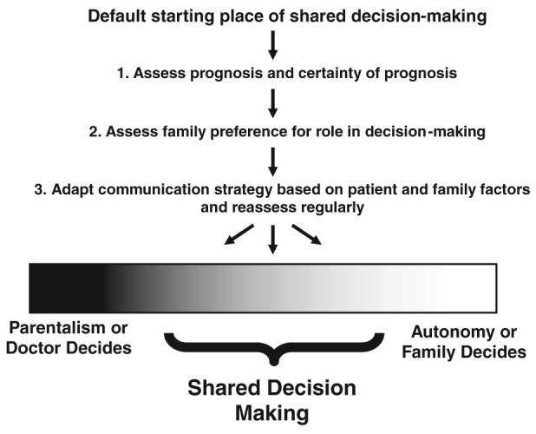
Three-Step Approach to Patient- and Family-Centered Decision Making
Curtis JR, et al. Chest. 2008; 134 (4): 835–843.

Slide 57
Evidence Based Communication Components
Conduct family conference within 72 hours of ICU admission
Identify a private place for communication with family members
Provide consistent communication from different team members
Increase proportion of time spent listening to family
Utilize empathic language
Identify commonly missed opportunities
Assure family that the patient will not suffer
Provide explicit support for decisions made by the family
Curtis JR, et al. Chest. 2008; 134 (4): 835–843.

Slide 58
VALUE Mnemonic for Improving Clinician-Family Communication in the ICU.
V Value family statements
A Acknowledge family emotions
L Listen to the family
U Understand the patient as a person
E Elicit family questions
Curtis JR, et al. Chest. 2008; 134 (4): 835–843.

Slide 59
Elements of Family-Centered Care in the PICU
Sharing information
Hearing parental voices
Making decisions for or with parents
Negotiating roles
Individualizing communication
Claire A. Richards CA, et al. J Hosp Palliat Nurs. 2017; 19 (3): 238–246.

Slide 60
Waiting, Waste and Critical Care
The biggest waste in medicine is waiting.
The underappreciated engine of Choosing Wisely® and (P)ICU Liberation is weaning:
→ Wean sedation
→ Wean mechanical ventilation
→ Wean (discontinue) drains and catheters
→ Wean (discontinue) antimicrobials
→ Wean (or minimize) immobilization
Proactive, scheduled weaning will reduce waiting.
Reducing waiting in the (P)ICU will increase value:
By improving quality
By decreasing the cost of waste

Slide 61
Choosing Wisely®
And The
Learning Healthcare Environment
In The
Intensive Care Unit
Patient Care
Includes quality
Improvement
activities like
Choosing Wisely®
implementation
Shared
Education
Clinical
Research

Slide 62
Facilitates delivery of evidence-based patient and family care
Fostering
A Learning
Healthcare
Environment
Promotes wellness for the community ICU practitioners

Slide 63
Promoting Value In Critical Care By
Implementing “Choosing Wisely® For Critical Care”
Review the original Choosing Wisely® For Critical Care.
Consider the Next Five Choosing Wisely® For Critical Care.
Identify the synergy between Choosing Wisely® For Critical Care and the (P)ICU Liberation A through F bundle
Enable a learning health care environment by incorporating evidence-based Choosing Wisely® For Critical Care elements utilizing quality improvement and shared education to improve patient care.

Slide 64
Saying Yes To Less by Choosing Wisely
Friedman JN. Saying Yes to Less. J Pediatr 2017; 184: 4-5.
Notes:
Achieving high value for our critically ill patients must become an overarching goal of our critical care delivery. This goal matters for patients and families and unites the interests of all healthcare stakeholders. When value improves, patients, payers, providers, and suppliers all benefit, and the economic sustainability of the health care system increases.

Slide 65
jerry.Zimmerman@seattlechildrens.org

