Slide 1
Carolinas Virginias Chapter SCCM
Annual Business Meeting

Slide 3
4 states: West Virginia, Virginia, North Carolina, South Carolina
Multidisciplinary
Current Membership 500+

Slide 4
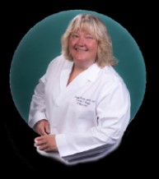
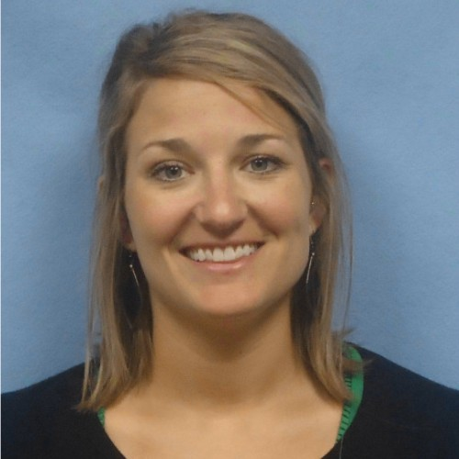
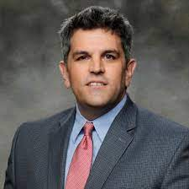
Executive Board of Directors
Kristie Hertel DNP, CCRN, ACNP-BC, FCCM
Current President
Jenna Cox PharmD, BCPS, BCCCP
President Elect
Todd Bourchers MSN, ACNP-BC
Past President

Slide 5
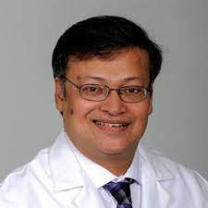
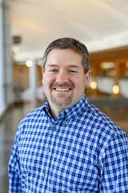
Executive Board of Directors
Saptarshi Biswas MD, FCCM
Secretary
Audis Bethea PharmD, BCCCP, BCPS
Treasurer

Slide 6
CVCSCCM Board of Directors
Carolyn | Magee | PharmD | SC
Desiree | Kosmisky | PharmD | NC
Bryan | Collier | DO | VA
Ankit | Sakhuja | MD | WV
Sameer | Kamath | MD | NC
George | Kasotakis | MD | NC
Andrew | Miller | RT | NC
Vishal | Yajnik | MD | VA
Taylor | O'neal | RN | SC
Nate | Cutler | MD | VA
Jason | Clark | MD | SC
Amanda | Edwards | PA | NC

Slide 8
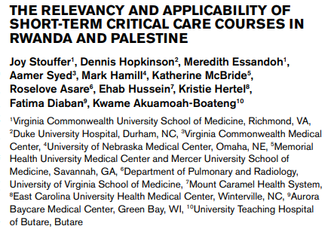
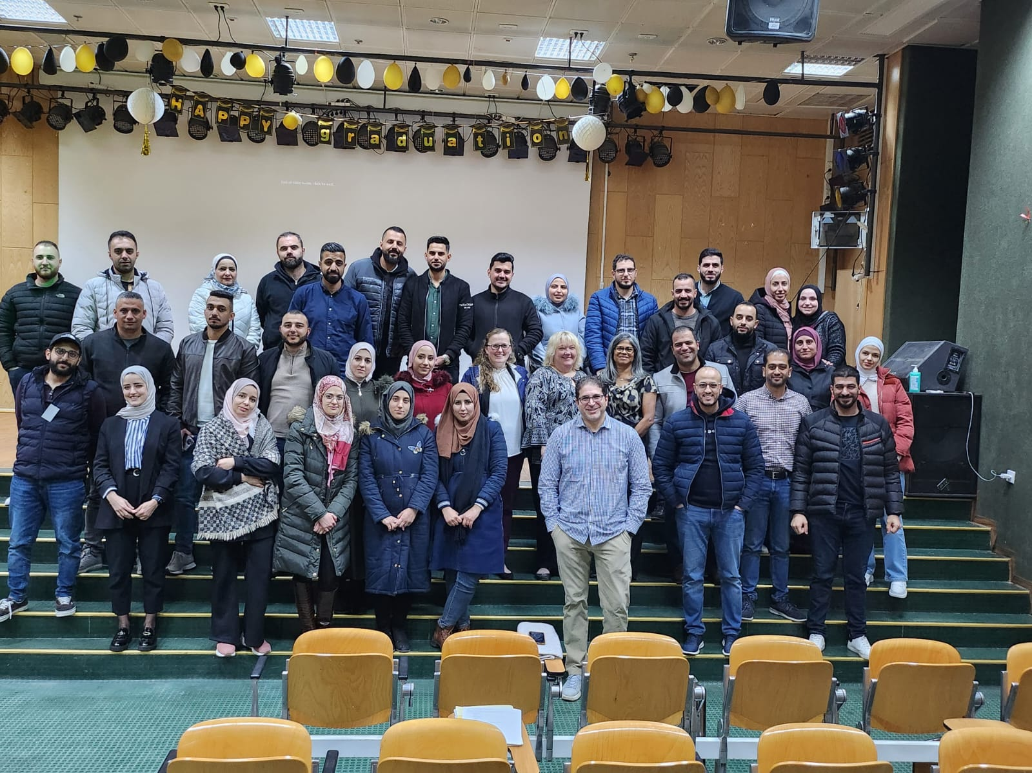
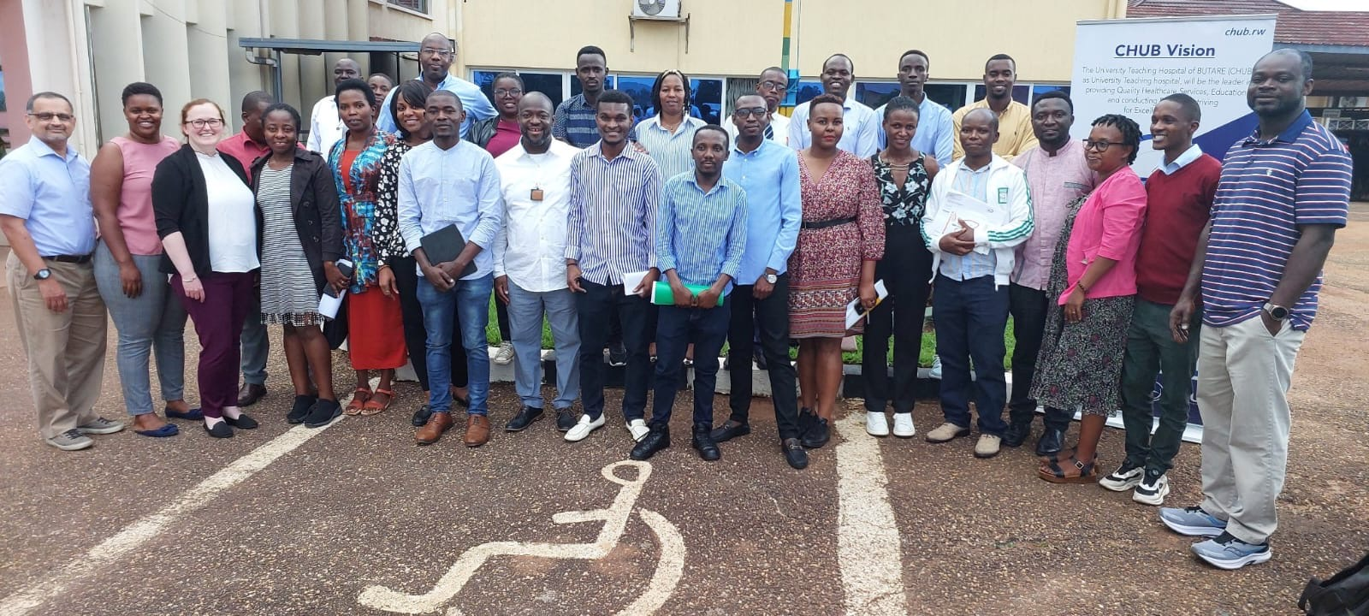

Slide 9
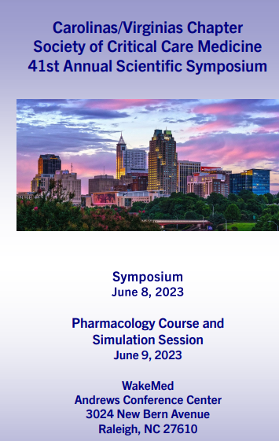
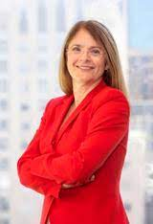
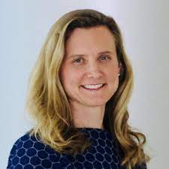
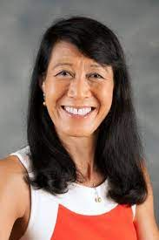
Lauren Sorce, PhD, APRN-NP, CPNP, AC/PC, FCCM
2023 Symposium Chair: Amanda Edwards PA-C
Cherylee Chang, MD, FACP, FNCS

Slide 10
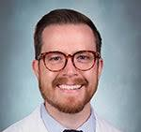
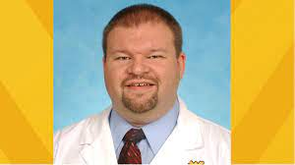
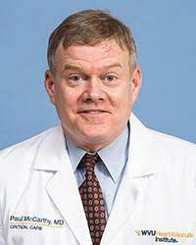
Presenter: Aaron Hudnall MD
Moderator: Greg Schaefer MD
Moderator: Paul McCarthy MD

Slide 11
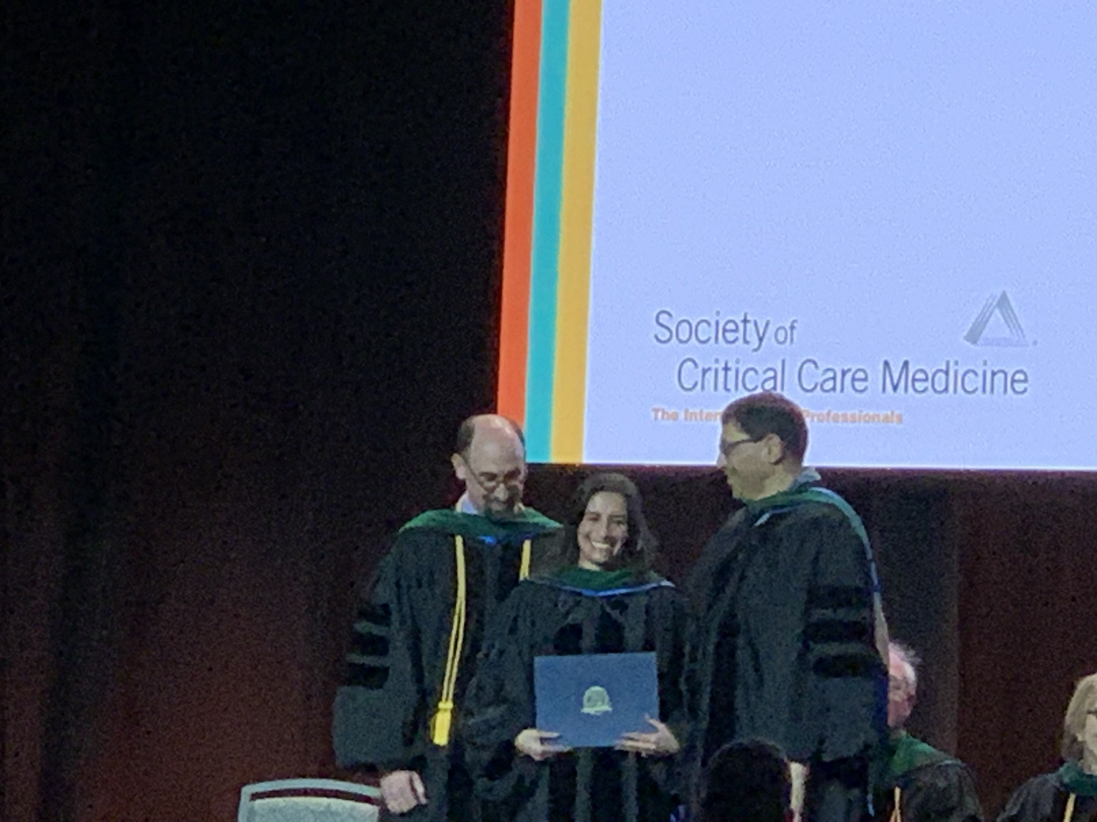
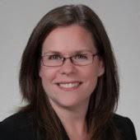
Lesly Jurado PharmD, BCPS, BCCCP, BCNSP FCCM

Slide 13
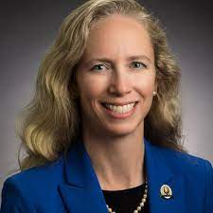
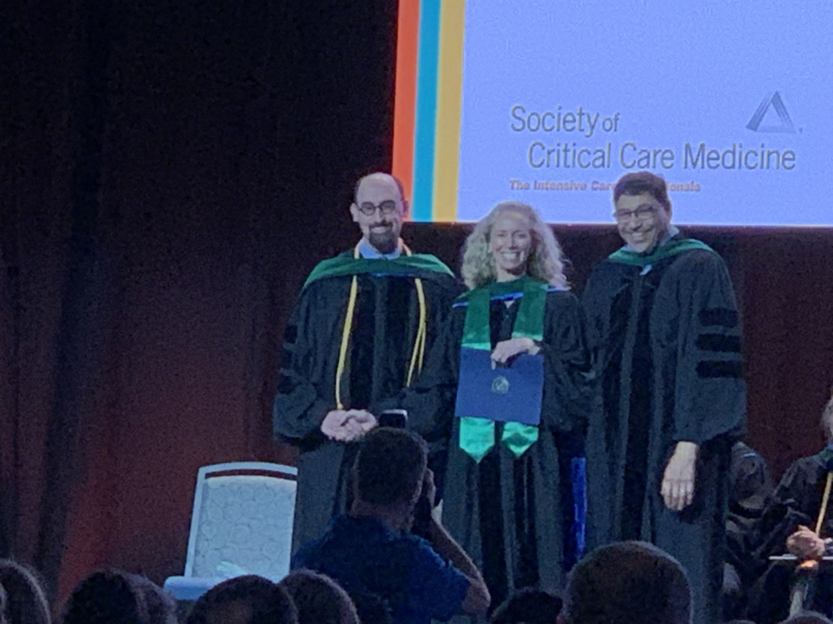
Heatherlee Baily MD,FAAEM, MCCM

Slide 14
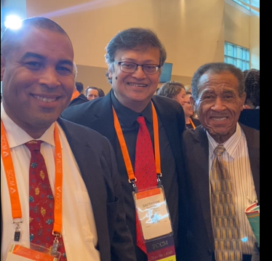
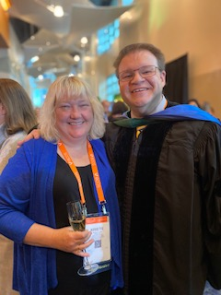
FCCM

Slide 15
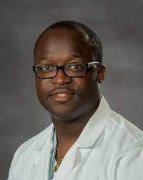
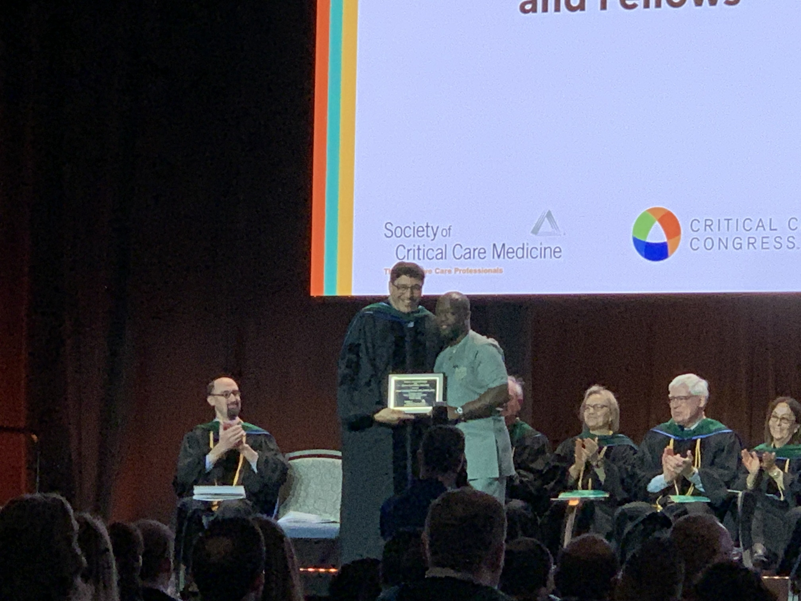
NORMA J. SHOEMAKER AWARD FOR CRITICAL CARE NURSING EXCELLENCE
This award, named in honor of founding Executive Director Norma J. Shoemaker, MN, FCCM, recognizes an SCCM nurse member who demonstrates excellence in critical care clinical practice, education and/or administration. The award provides travel funding for participation at SCCM's Annual Congress.
Kwame Akuamoah-Boateng, DNP, ACNP-BC, MSN, FCCM

Slide 18
Treasurer Report
Account Balance- $92,000 +
Venmo- no d/t tax complications
Paypal- still using but charges fee
Looking for alternative ways to pay/receive funds that is convenient without using checks

Slide 19
Education
Committee Chair
Lesly Jurado
Leslyvjh@gmail.com
Annual Scientific Symposium
Hilton, Mrytle Beach, SC
June 13- pharmacology pre-conference
June 14- symposium
Journal Clubs
Monthly
First given in November- New SCCM/IDSA Fever Guidelines
January started Monthly
Watch SCCM connect for date/time/link
Meets Monthly
Third Wednesday of month at 2pm

Slide 21
Date/Time: February 14, 2024 from 1-2 pm
Moderator:
Adam Schertz, MD
Clinical Assistant Professor
Department of Internal Medicine
Section of Pulmonary, Critical Care and Sleep Medicine
University of South Carolina Greenville School of Medicine
X (Twitter): @aschertzmd
Presenters:
Fluid balance control in critically ill patients: results from POINCARE-2 stepped wedge cluster-randomized trial. Crit Care 2023;27(1):66. Fluid balance control in critically ill patients: results from POINCARE-2 stepped wedge cluster-randomized trial - PubMed (nih.gov)
Gary Zhang, MD
2nd Year Trauma/Critical Care Fellow
East Carolina University
Early adjunctive methylene blue in patients with septic shock: a randomized controlled trial. Crit Care 2023;27(1):110. Early adjunctive methylene blue in patients with septic shock: a randomized controlled trial - PubMed (nih.gov)
John Dubensky, DO
Surgical Critical Care Fellow
Eastern Virgina Medical School

Slide 22
Mentorship
Committee Chair
Alyssa Lear
Alyssa.lear@atriumhealth.org
Pairing of Mentor/Mentees
FCCM
Research
Professional development
No set meeting times

Slide 23
Communication
Committee Chair
Jana Sigmon
Jasigmon31@gmail.com
Biannual newsletter
Member spotlights and committee updates
Quarterly Critical Connection article
Published by SCCM and delivered to all SCCM members
Allows chapter to announce activities to all of society membership
Social media
X (formally twitter)
Instagram
Facebook
Chapter website
Find forms to join committees, updates on latest chapter events
CVCSCCM.org
Chapter SCCM connect
Anyone can post
Most frequently used method to communicate with members; must set up connect account or you will not receive emails
No set meeting schedule, email communication

Slide 24
Membership
Committee Chair
Donnie Goodwin
Donnie.goodwin@wvumedicine.org
Membership Drive
Annual
SCCM sends out once a year push to all members in region
Letter to training programs directors in June
Membership Retention
Chapter welcome letter
Monitoring of membership expectations
Survey sent to new members
Organization of Congress networking night
Organization of symposium networking event
Email communication and meetings as required

Slide 25
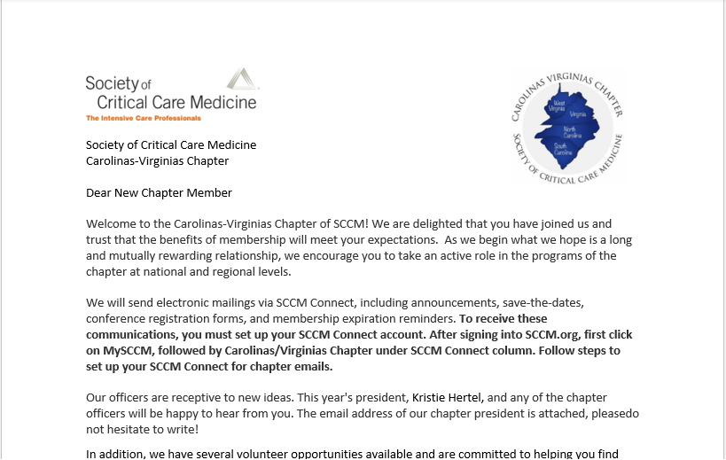

Slide 26
Membership Poll
How did you about this chapter50% a colleague
50% SCCM
Are you involved in other organizations
ACS/SCCM
Are you interested in joining a committee
50% Yes
Did the cost of the membership deter you from joining sooner
100% No
How long of time span from learning about this chapter until joining
100% <1` year
What is your goal of joining this chapter
50% networking, 50% professional development
Did you join SCCM prior to join this chapter
100% yes
What are some ways to increase membership-
word of mouth
2.encouraging young members
3.learning opportunities
This survey was sent out for the month of July-Aug to new members

Slide 27
Outreach
Committee Chairs
Greg Schaefer; gschaefer@hsc.wvu.edu
Paul McCarthy; paul.mccarthy@wvumedicine.org
Working to incorporate education and support within community
FCCS
Going to strive for 1 course in rural are of chapter region every year
Utilize chapter members as instructors
Stop the Bleed
Annual Scientific Symposium
Include community such as employees of hotel

Slide 28
International Outreach
Committee Chair
Katherine McBride; katherinemcbride@gmail.com
Aamer Syed; aamer.syed@vcuhealth.org
Annual Rwanda Trip
Started in 2018
Returned 2019, 2022, 2023
Plan return 11/2024
Accommodations and transportation supported by chapter
International FCCS in resource limited countries

Slide 29
Research
Committee Chair
Casey Cable
Casey.cable@vcuhealth.org
9 current research projects
Multiprofessional
Multi institutional
5 projects in consideration
Committee meets every 3rd Thursday of month

Slide 30
What’s New
Monthly Journal Club
Activity Tracker
STB at symposium
Instagram
Strategic Plan

Slide 31
Stay Connected
SCCM Connect
To receive these communications, you must set up your SCCM Connect account. After signing into SCCM.org, first click on MySCCM, followed by Carolinas/Virginias Chapter under SCCM Connect column. Follow steps to set up your SCCM Connect for chapter emails.

Slide 32
Stay Connected
Website: CVCSCCM.org
Twitter: @CVCSCCM
Facebook: “SCCM Carolinas/Virginias Chapter” and request to join the closed group
Instagram: @CVCSCCM

Slide 33
Volunteer and Join
Go to CVCSCCM.org
Click on Committee you are interested in
Email the chair of that committee
Go to CVCSCCM.org
Click Committees
Review Committees
Choose a committee
Email CVCSCCM@gmail.com

Slide 34
