Slide 1
OHSU Code Blue Response in the COVID19 Pandemic
April 7, 2020
Miko Enomoto, MD / Kit Lum, BSN, RN, CCRN-CSC / Jamie Payne, BSN, RN, CCRN

Slide 2
What is the same?
Focus on timely intervention
Focus on high quality CPR and appropriate medications/ support

Slide 3
What is different?
Prioritize Team Safety
Appropriate PPE for AGPs for all providers in the room
Gatekeeper
Limit aerosols
Trialing use of mask on patient during chest compressions
Trialing plastic sheet
Altered airway management
Limit the number of people in the room
Lucas Device for automated chest compressions
Use two way communication technology

Slide 4
COVID Code Blue
Acute Care Units w/ COVID
Critical Care Units w/ COVID
Unconscious, not breathing, and/or pulseless:
Activate ADULT CODE BLUE
For NON URGENT airway assistance:
Notify Respiratory Therapist
Notify Anesthesia Consult
For URGENT airway assistance:
Activate URGENT AIRWAY TEAM by dialing
Cardiorespiratory Arrest or additional assistance needed:
Activate ADULT CODE BLUE to location
Entry into room will depend on roles that need to be filled

Slide 5
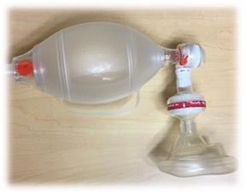
COVID Code Blue First Responders:
“2 in the room” Limit to 2 area personnel (RN or MD) in room as First Responders:
A Code Blue activation automatically enacts AIRBORNE + CONTACT + EYE PROTECTION
First Responder: immediately add appropriate airborne protection before performing any Basic Life Support (BLS) interventions
2nd Responder dons AIRBORNE + CONTACT + EYE PROTECTION and brings into room:
AED/Defibrillator + pads
Backboard
“2 in the room” perform BLS interventions as clinically indicated
IF PULSELESS: Chest compressions, early defibrillation of shockable rhythm
Place surgical mask over patient’s mouth prior to beginning chest compressions
IF NOT BREATHING: Bag Mask Ventilation (BMV)
Ensure THERMOFLO filter is connected to ambu bag and ambu bag is connected to high flow oxygen
DO NOT PERFORM ANY BLS INTERVENTIONS UNTIL AIRBORNE + CONTACT + EYE PROTECTION IN PLACE FOR ANYONE IN ROOM
Thermoflo filter attached between bag and mask

Slide 6
COVID Code Blue Area personnel assist with the following:
Activate Code Blue team by dialing 4-8222
Bring local supply of N95 masks, face shields, and PAPRs (if available) to isolation cart outside of room
Bring local code cart outside of room
Enact GATEKEEPER role

Slide 7
Gatekeeper Role
ONLY ESSENTIAL personnel in room
Properly don appropriate PPE: airborne + contact + eye protection
Minimize door opening/closing as possible
Minimize unnecessary equipment entering room
Ensure all equipment used is appropriately cleaned prior to exiting room
Ensure all personnel properly doff PPE prior to exiting room
Observer/ PPE BUDDY
(VOCERA “PPE BUDDY” or Call 8-4040 to request)

Slide 8
Code Blue Responders
 | Code Blue Team Leader | Anesthesia | Respiratory Care | Pharmacy
ENTERS ROOM? | YES | YES | YES | NO
PPE | Airborne + Contact + Eye Protection | Airborne + Contact + Eye Protection PAPR Preferred | Airborne + Contact + Eye Protection PAPR Preferred | Mask & Gloves Only
BRINGS TO LOCATION | None | COVID Response Bag | None | None
RESPONSIBILITIES | Direct BLS and ACLS protocols | Perform airway interventions | Bring into room: ambu bag + filter (if not present) Assist with airway interventions | Prepare requested medications

Slide 9
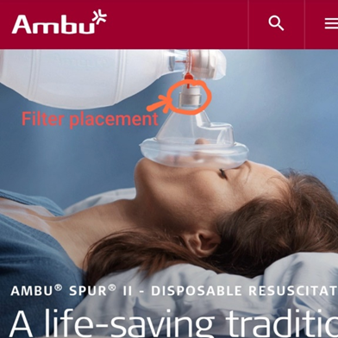
Airway Management Principles
Surgical mask or plastic sheet over patient’s mouth when initiating chest compressions
Consider compression only CPR until appropriate HME filter available Intubate early
Minimize bridging with HFNC or NIPPV
Most experienced laryngoscopist
Ensure hydrophobic filter in place for preoxygenation +/- BMV
Consider Video laryngoscopy
HOLD COMPRESSIONS DURING INTUBATION until cuff inflated

Slide 10
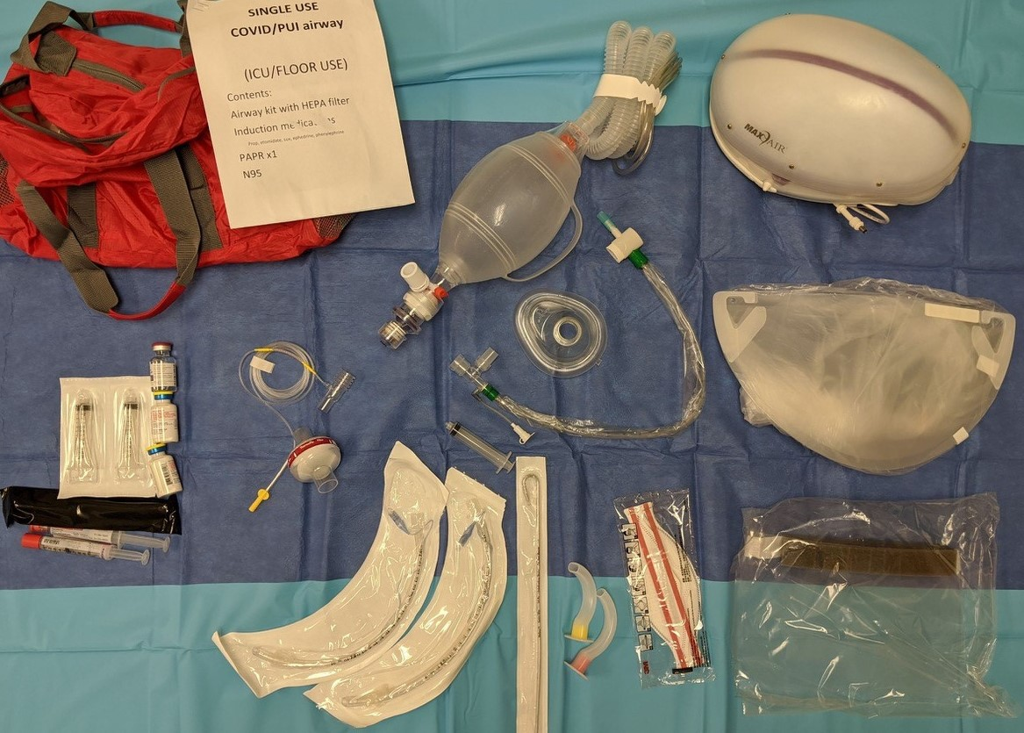
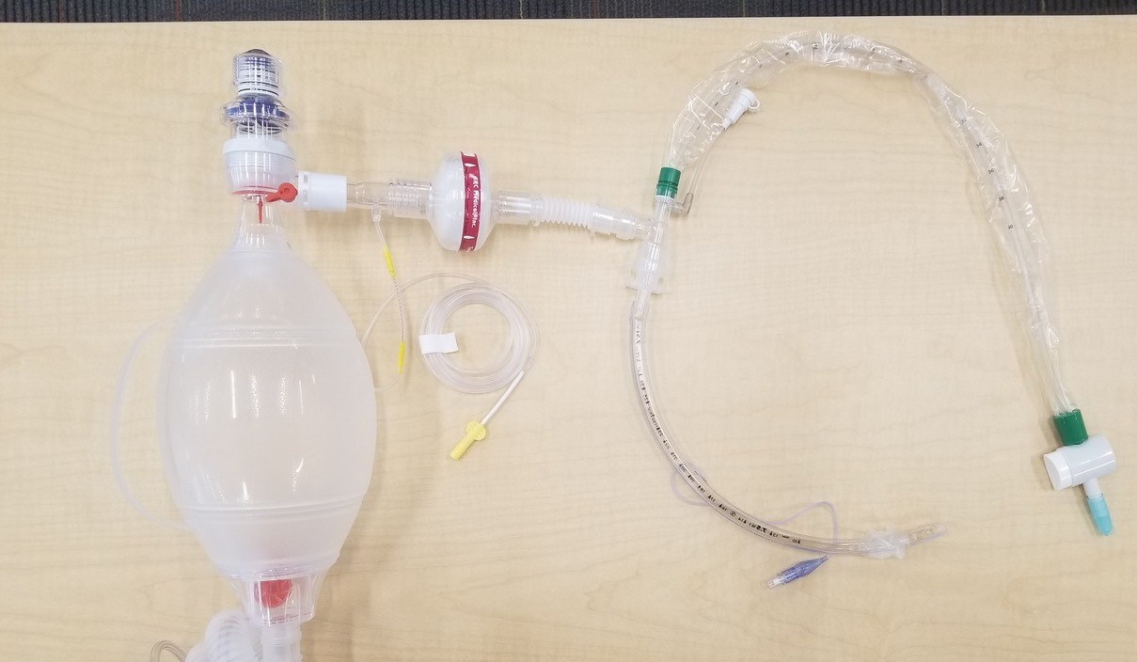
Airway, continued
RT to connect: O2 source + ambu + PEEP valve + EtCO2 + HME filter +connector + in line suction + ETT ➔ patient
Clamp ETT if circuit disruption necessary
https://twitter.com/lopezrobMD/status/1242977863319486464

Slide 11
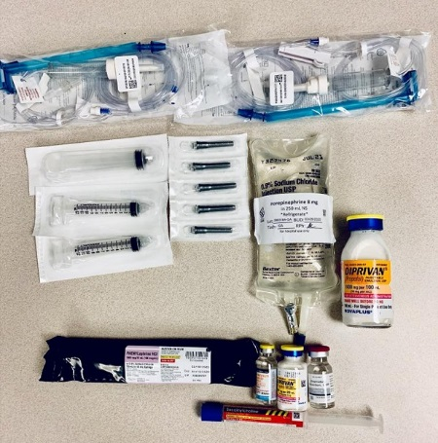
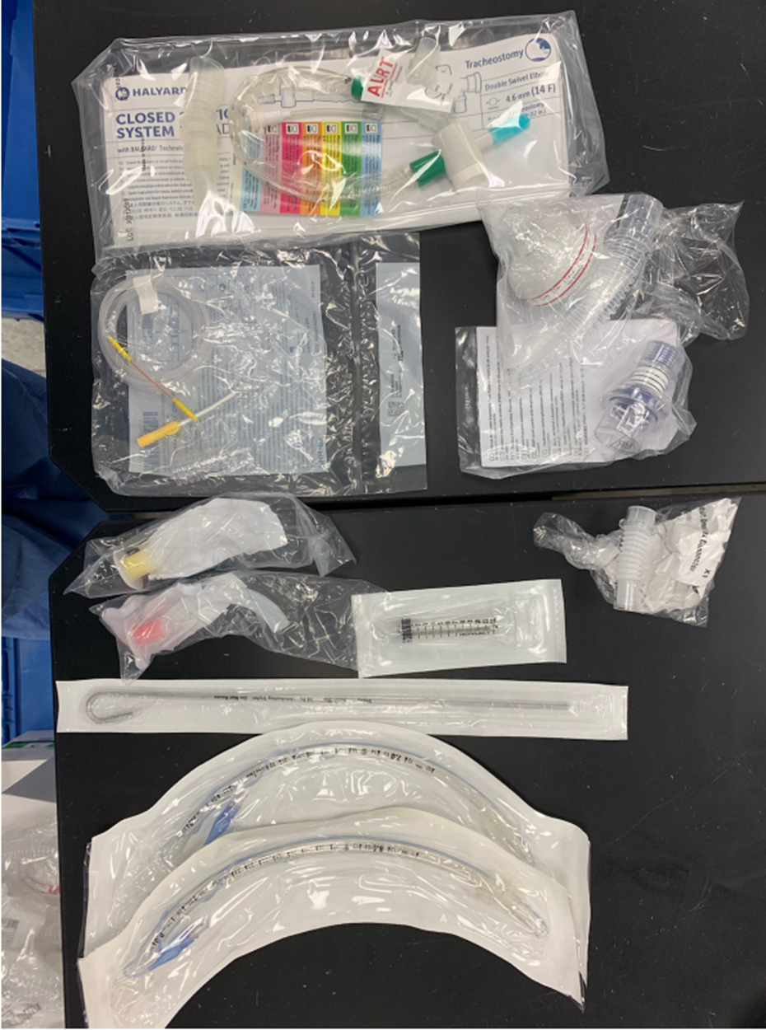
Anesthesia COVID Response Bag Anesthesia takes to all Adult Code Blue responses
RX KIT CONTAINS:
Succinylcholine Rocuronium
Propofol
Etomidate
Norepi bag
Alaris Tubing x2
20mL syringe
10mL syring x2
Needless cannulas x5
AIRWAY KIT CONTAINS:
Oral airways (yellow & red)
Cuffed ETT (size 7.0 & 8.0)
Standard Stylet
10mL syringe
In-line suction catheter
Small Omniflex adapter
HEPA filter
PEEP valve
ETCO2 line
**GLIDESCOPE NOT INCLUDED**
ORANGE RESPONSE BAG CONTAINS:
PAPR + Face Shield
N95 mask
COVID Rx Kit
COVID Airway Kit

Slide 12
Code Blue RN Responders
 | 12K RN Code Blue Responders | MICU CPRN
ENTERS ROOM? | Acute Care: 1 of 2 YES ICU: MAYBE depending on need | Acute Care: YES ICU: MAYBE depending on need
PPE | Airborne + Contact + Eye Protection Mask + Gloves only if outside room | Airborne + Contact + Eye Protection Mask + Gloves only if outside room
BRINGS TO LOCATION | RRT Response Bag iPad for Full Code Pro | Covid Code Blue Response Bag InTouch cart + iPad
RESPONSIBILITIES | IN ROOM: assist with Lucas deployment, defib operation, any other role as needed Bring into room: RSI med bag, Defibrillator OUTSIDE: Log into TouchSmart iPad, recording/timekeeping with Full Code Pro, hand in requested supplies | Leave iPad outside room on arrival Bring into room: InTouch, Med Supplies bag, Airway bag, Lucas device (as needed) IN ROOM: Assist with Lucas deployment, drug prep/admin, any other role as needed

Slide 13
COVID Code Blue Response Bag MICU CPRN takes to ALL Adult Code Blue Activations
COVID CODE RESPONSE BAG CONTAINS:
Lucas Device + backboard + neck strap
PAPR + Face Shields
Airway Bag
Med Supply Bag
COVID Code Blue PPE
TAKE INTO ROOM PRN
For automated chest compressions
LEAVE ON ISO CART OUTSIDE ROOM
Prioritize allocation to RT or Anesthesia
Contents:
Glidescope Size 3 & 4 blades
Rigid stylet COVID Airway Kit
COORDINATE WITH ANESTHESIA
Contents:
EZIO Drill 25mm/40 mm needle pack
Chlorhex swabs x2 10mL syringes x5 20mL syringe x2 20G needles x5 Needless cannulas x5 NS Flushes x15
Pink tape roll Suction canister + lid
Suction tubing Yankauer
TAKE INTO ROOM
LEAVE OUTSIDE ROOM
For use as needed

Slide 14
InTouch Cart + iPad MICU CPRN takes to all Adult Code Blue activations
For Use at Code Blue:
Take to code blue location
Don appropriate PPE
Unplug and leave iPad outside of room
Wheel cart into room
Position at foot of bed at angle from corner & lock wheel
Move monitor to highest position
Await connection by iPad from outside of room
View can be directed by iPad from outside room
Provides visualization to recorder RN and team in hallway
Provides two way audio

Slide 15
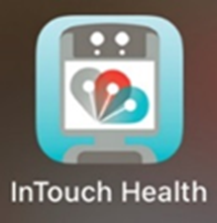
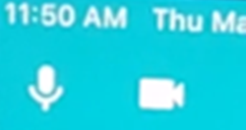
RRT Response Bag, iPad w/ Full Code Pro 12K Responders take to ALL Adult Code Blue Activations
One 12K RN Responder will don appropriate PPE and take into room:
Defibrillator
RSI med bag (coordinate with anesthesia)
One 12K RN Responder (Recorder RN) will remain outside room and:
Connect InTouch iPad to InTouch cart in room
Touch iPad home button twice to start
Open InTouch Health App
Log on
The iPad will connect to the monitor in the room for 2-way communication
Ensure microphone is unmuted on top left corner
Use Full Code Pro iPad to document & keep time

Slide 16
Doffing and Transport
Doffing is high risk for contamination or HCP
Do not transport if ongoing CPR/ AGPs
Once patient stable:
Provider(s) [ RT, Medication RN] needing to maintain close physical contact with patient remain in PPE (if time allows, doff and don clean gown and gloves)
Others doff PPE (with observer), hand hygiene, new gloves
Clean sheet over patient/ bed
One team member on elevator/ clear hallway
One team member pushing bed/equipment should wear full clean PPE

