Slide 1
Update Helmet Noninvasive Ventilation J. Gotchall, MD Mar. 31, 2020
This is keeping it short, giving you resources
Helmet Noninvasive Ventilation, Italian model
Don’t think of HNIV as BiPAP/CPAP
Do think of HNIV as Big Mixing Chamber with
High Flow Oxygen (FiO2 ~ 73%) and
PEEP 5-20 cm and
Expiratory Limb Filter.
Less particle droplet dispersion than HFNC or facemask interface

Slide 2
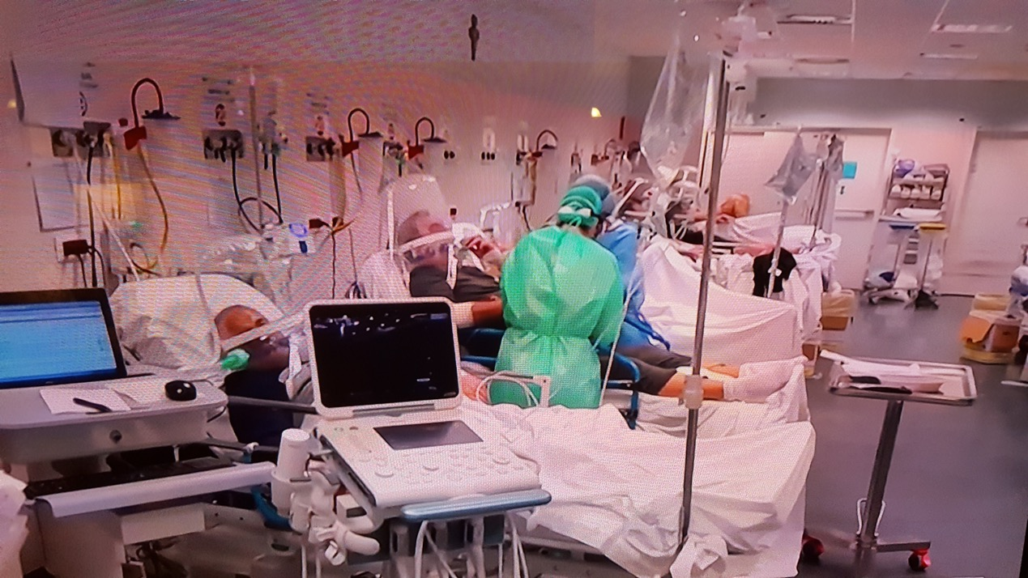
How to do this linked here
Screenshot of 8-bed HNIV ICU in Italy, Today Show, March 21, 2020

Slide 3
Materials List
DEVICE | Components | Description | Resource | Cost, estimate | Comment
Sea-Long Helmet | Sea-Long Helmet | Helmet Oxygen Tent | at www.Sea-Long.com |  | Tested, backorder
Amron Helmet | Amron Helmet | Helmet Oxygen Tent | at www.amronintle.com
 | Wall Gas Source, High Flow
 | Inspiratory Limb | (3) Gas Regulators | (2) Oxygen (flush) | (1) Medical Gas (flush)
 |  | (3) Oxygen Tubing (7-foot) |  | $1 / ea
 |  | (1) length standard corragated tubing |  | $0.18 / ft
 |  | (1) Concha Tube Adapter | Hudson RCI 384-00 | $2 / ea
 |  | (2) Oxygen enrichment attachment | Respirionics 312710 | $5-7 / ea
 |  | (1) 15 mm I.D./22 mm O.D. adapter |  | $0.44 / ea
 |  | Humidity (optional, intermittent)
Just a sample, more complete list on my Google Drive folder linked here

Slide 4
Supply Chain Issues
“Just in time inventory” makes little sense for resp or PPE today
Orders drive production
Expedite w/ Prepaid Orders
Remember: DME/Resp equipment is “durable” Resp equipment generally nonperishables with long shelf life
Maybe hospitals/states can redistribute surplus to areas of need
Anticipate shortages in
Ventilators
Helmets
PEEP valves
Other oxygen circuit supplies

Slide 5
Reminders
Happy to discuss
Google Drive Folder with details linked here
Work in progress
Expect iterations
Send us your results and experiences! OFRRmail@gmail.com
Fill out the survey
Conflicts of Interest: none

