Slide 1
COVID!
Tom DeLoughery, MD MACP FAWM
Oregon Health & Science University
@bloodman

Slide 2
DISCLOSURE
Current Relevant Financial Relationship(s)
None

Slide 3
What I am Discussing
Coagulopathy in COVID-19
Use of anti IL-6 agents
Use of convalescent plasma
Utility of antibody testing
Oncology Patients

Slide 4
Coagulopathy in COVID-19
Very common!
Most patients with
Abnormal coagulation
Very high D-dimers
Very high fibrinogen
Thrombosis >> bleeding

Slide 5
D-Dimer
Marked elevation in all patients
Major prognostic indicator
May be a sign of thrombosis
Cause
Widespread coagulation activation
Pulmonary thrombosis

Slide 6
D-Dimer
D
E
D
D
E
FPA
Thrombin
Plasmin
E
E
D
FPB
D
D
D
D
Fibrinogen
Fibrin
Monomer
E
D
D
D-Dimer
X-Linked
Fibrin

Slide 9
Thrombosis
Rates of 17-25% reported even with prophylaxis
Much higher than literature
Venous thrombosis
Arterial thrombosis
Microthrombosis

Slide 10
Cui
VTE = 25%
Unknown prophylaxis
D-Dimer predictive
J Throm Hem 2020

Slide 11
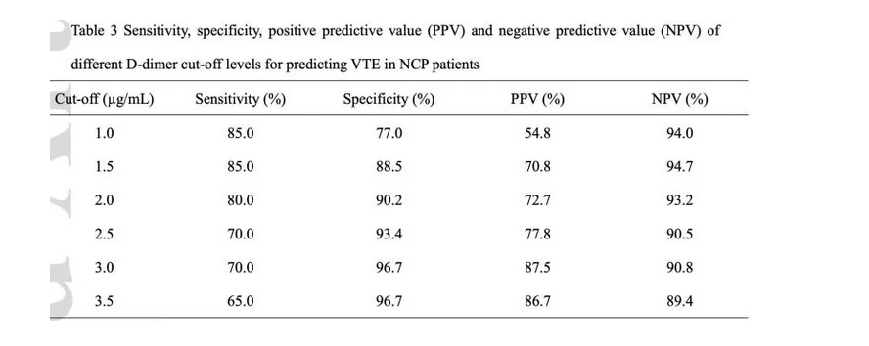

Slide 12
Klok
VTE = 27% (80% PE)
Arterial = 3.7%
All getting prophylaxis
Coagulation abnormities predicted thrombosis
Throm Research 2020

Slide 13
France
16.7% thrombosis rate
96% CRRT thrombosis rate
All getting prophylaxes
ICU medicine in press

Slide 14
Middledorpf
17% thrombosis rate
34% cumulative at 2 weeks of ICU
2.4%/day of ICU stay
Preprint

Slide 15
Thrombosis Rates
COVID: 17-27%
Non-COVID ICU
14.6% Controls (2% PE)
7.5% Prophylaxis (1%)

Slide 16
Heparin Resistance
Increasing reports of high heparin requirements
> 4000u/hr
High rates of CRRT/dialysis thrombosis

Slide 17
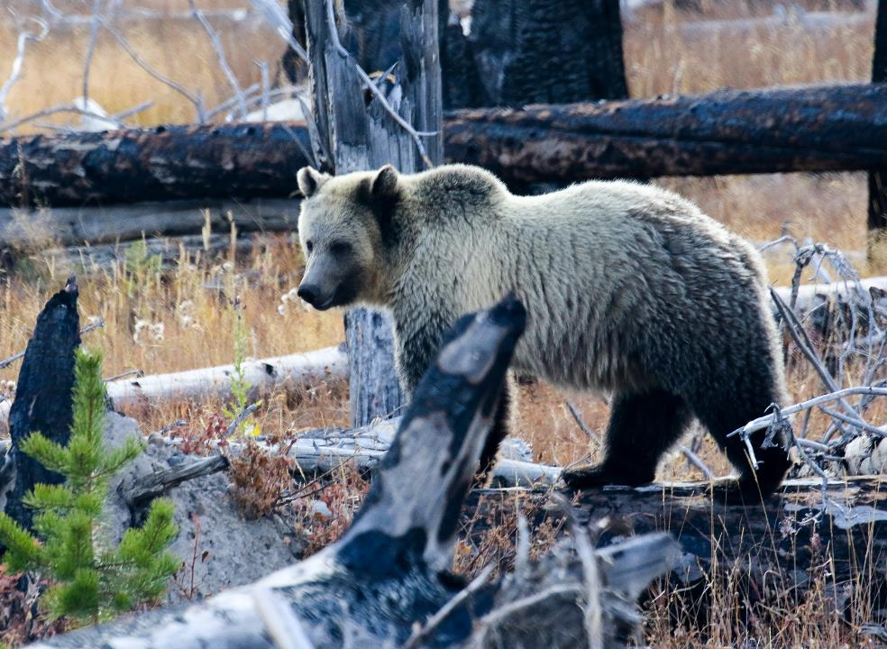

Slide 18
Etiology
Intense inflammation
Raises procoagulants
Convert endothelium to prothrombotic state
Pulmonary inflammation
Viral attach on endothelial cells

Slide 19
Inflammation
IL-6 stimulates prothrombotic changes
Increased fibrinogen
Increased factor 8
Increased VWF

Slide 20
Pulmonary Inflammation
Virus infection at alveolar level leads to local inflammation
Increasing reports of pulmonary microthrombi

Slide 23
Endothelial Infection
Increasing evidence virus can attached vascular endothelium
Converts antithrombotic surface to prothrombotic

Slide 25
Anticoagulation
Consensus
Everyone hospital for COVID gets thromboprophylaxis with LMWH (UFH if renal failure)
Controversy
Everything else

Slide 26
Is Heparin Beneficial
Teng study showed heparin associated with increase survival esp with high d-dimers
Prophylaxis not standard in China
Unclear doses used

Slide 28
Increase Dosing?
Many protocols increase heparin dosing for
ICU patients
D-Dimers 1.5- 3 x normal
LMWH 40mg bid
30% of coagulation doctors favor

Slide 29
Therapeutic Dosing
Some centers starting therapeutic dosing with D-Dimer 3-6x normal

Slide 30
Outpatient Prophylaxis
Some advocate after discharge prophylaxis for 30-45 days due to perceived high risk of thrombosis

Slide 31
A Reasonable Approach
Prophylaxis for all
Screen for DVT at admit to ICU then every 4-5 days
Low threshold to go to therapeutic at suspicion of thrombosis

Slide 32
Heparin Resistance
Etiology
Increased inflammatory proteins
Increased fibrinogen, etc absorb heparin
Interference with PTT
Prothrombotic drive

Slide 33
Heparin Resistance
Solution
Use LMWH as much as possible
If using UFH use heparin levels
Breakthrough: increase LMWH by 25% or use argatroban

Slide 34
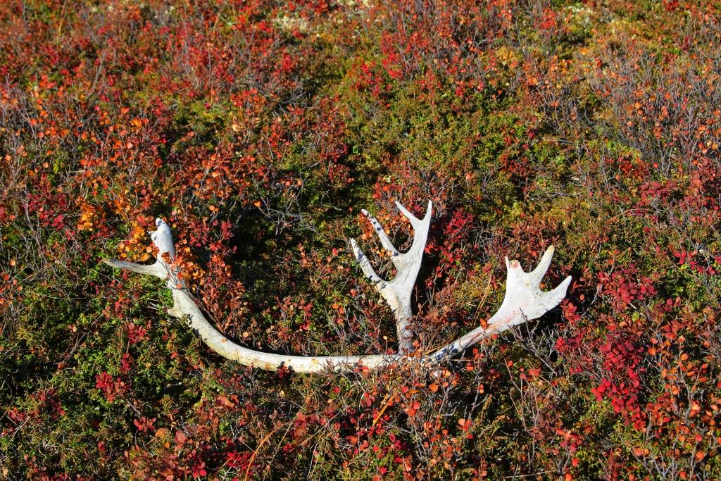

Slide 35
Use of Anti IL-6 Agents
COVID infection leads to inflammation
5-7 days decompensation mediated by “cytokine storm”

Slide 37
IL-6
Release of IL-6 induces inflammatory response
Acute phase proteins
Fevers
Cytokine storm!

Slide 38
Why Anti-IL-6
Key mediator of inflammation
Works in cytokine storms with CAR-T cell therapy
We have antibodies to it
Promising early reports

Slide 39
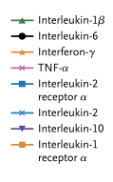
Cytokine Strom
Notes:
humanized monoclonal antibody against the interleukin-6 receptor

Slide 40
CRS Treatment
Notes:
humanized monoclonal antibody against the interleukin-6 receptor

Slide 41
Patient 1 NEJM
Notes:
humanized monoclonal antibody against the interleukin-6 receptor

Slide 42
Problems
Therapies targeted to just one cytokine have negative clinical trial record
No good clinical data
Can be immunosuppressive
Current shortage of agents

Slide 43
Other Agents
Ruxolitinib
Blocks JAK1/2
Decreased multiple inflammatory markers
Works in hemophagocytic syndrome

Slide 44
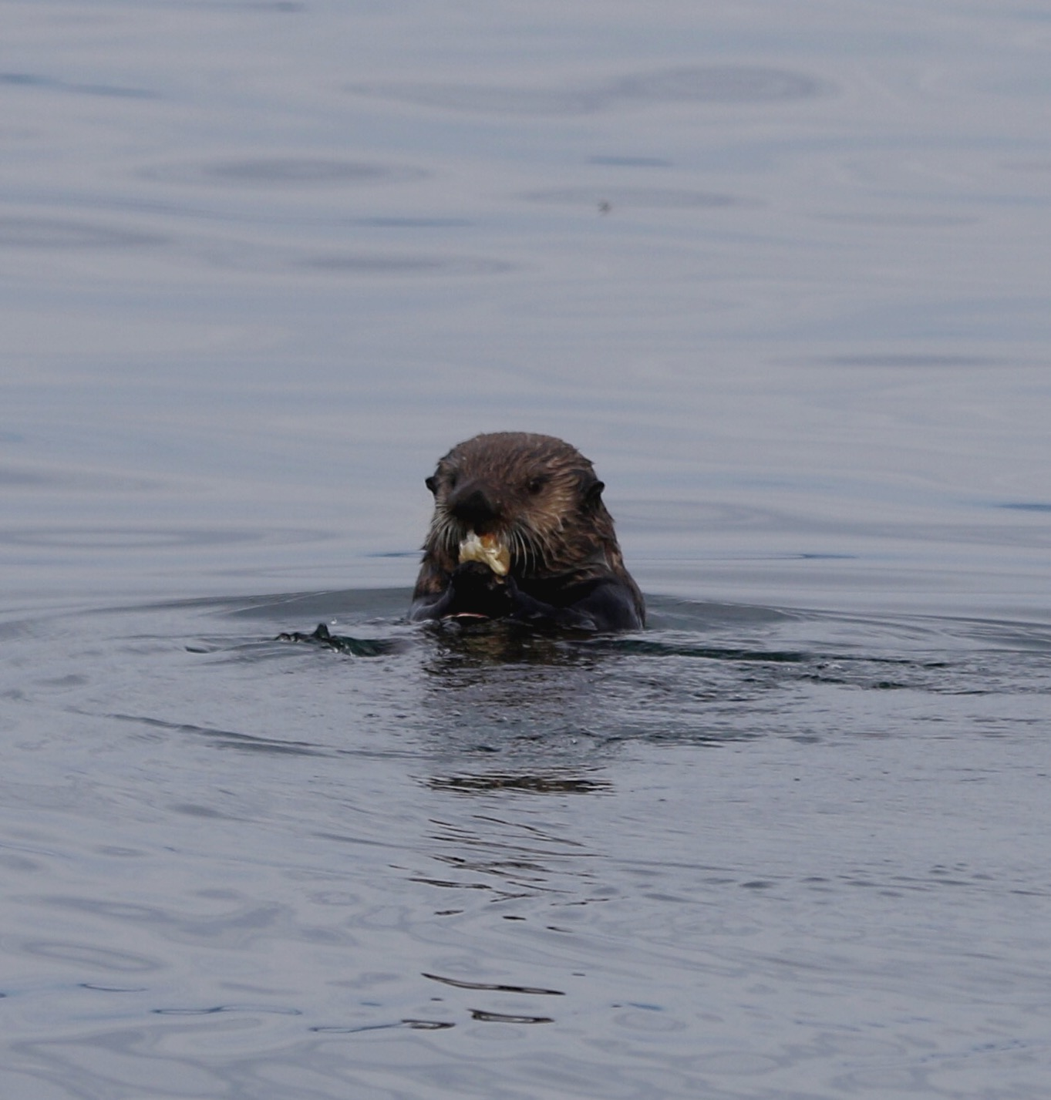

Slide 45
Two Other Heme Topics

Slide 46
Ferritins
Massive elevations of ferritin reported
Marker of inflammation
Made by activated monocytes
Parallels inflammatory response
No relationship to iron stores

Slide 47
“Hemoglobin Damage”
Paper theorized this
Problems
Computer modeling
RBC can’t be infected by virus
No clinical signs of hemolysis etc

Slide 49
Use of Convalescent Plasma
Incredible hope and speculation about this
Multiple trials/protocols in process

Slide 50
Convalescent Plasma
Very old idea
Antibodies in donor convalescent plasma can decrease infection in recipient
Two types
Plasma
Hyperimmune globulin

Slide 51
Hyperimmune Globulin
Long track records of effectiveness
Process
Patients know to have high titers
Plasmapheresis
Fractionation to isolate IGG
Concentrate given to patient

Slide 52
Convalescent Plasma
Patient documented to have infection
Ideally with high titers of ab
Unit of whole blood drawn or plasmapheresis
Plasma spun off and frozen
FDA IND needed for COVID

Slide 53
Issues
Plasma raised IgG by ~5%
Lack of antibody testing
Are high titers neutralizing?
Many anecdotes but negative RCT studies in other disease

Slide 55
Utility of Antibody Testing
Current testing PCR based
False positive reported
Great for acute testing
Cannot determine past infection

Slide 56
Antibody Testing
IgG: clear infection (immunity?)
IgM: active infection
Determine past infection
Determine plasma donation
IgM acute infection?

Slide 57
Issues
Simple to make assay
Difficult to make good one!
False-positives
Right antibody/protein target
Does + test imply immunity
Very few test FDA authorized
Cellex, Ortho Clinical Diagnostics, Chembio Diagnostic Systems and the Mount Sinai Laboratory.

Slide 58
New York Times
4/19/202

Slide 59
Bottom Line
Not ready for prime time
Need to have
Low false positive and negative rates
Understand what antibody response is protective

Slide 60
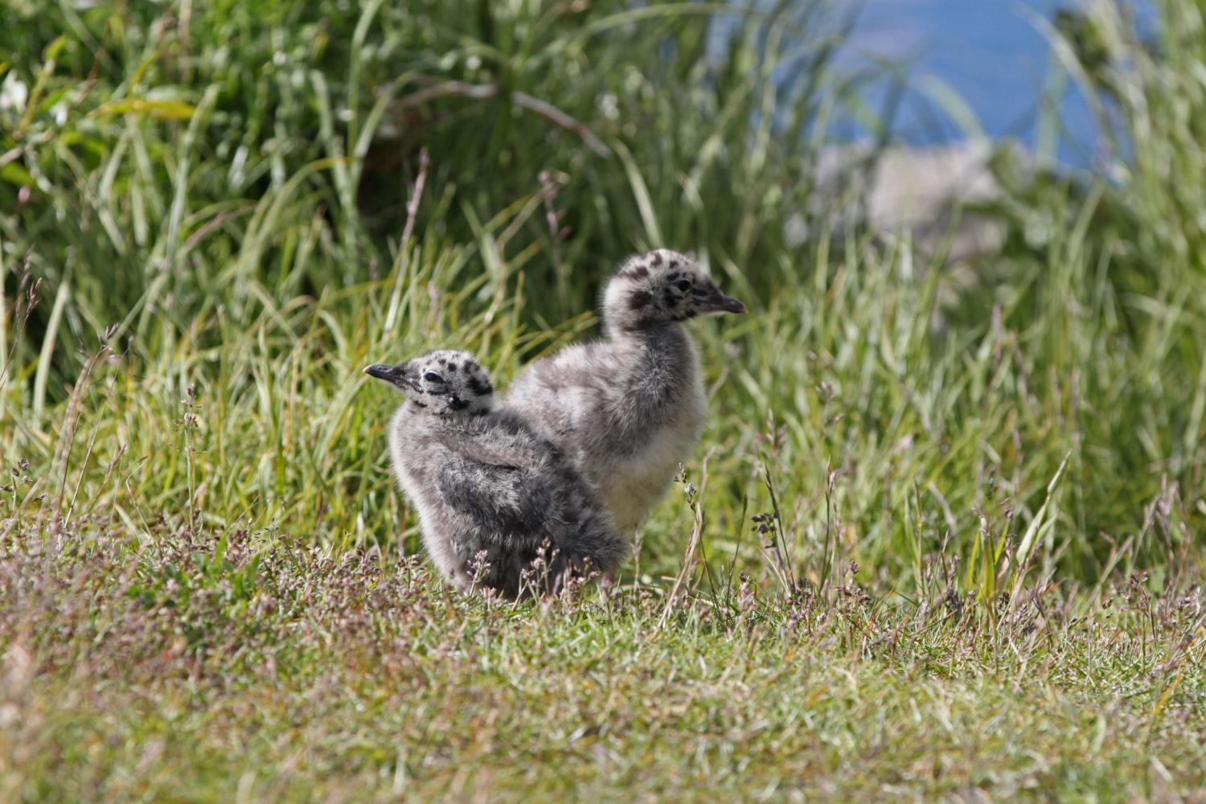

Slide 61
Oncology Patients
Do worse with COVD infection
Higher infection rate
Higher complication rate
But many need constant exposure to health care

Slide 62
Delaying Care
Maintenance therapy
Delay infusion
Cut back monitoring
Delay or use virtual visits

Slide 63
Clinics
Separate “COVID” infusion/clinic
Social distancing
Mask
No visitors

