Slide 1
PADIS, ABCDEF, and ERAS Sorting Through the Alphabet Soup
John Hammer, PharmD, MBA, BCPS, DPLA
Lauren Macko, MSN, RN, ACCNS-AG, CCRN, SCRN
Erin (Allender) Ledford, PharmD, BCPS- AQ Cardiology, BCCCP

Slide 2
Disclosure
We have no conflicts of interest to disclose

Slide 3
Objectives
Summarize key recommendations from the 2018 PADIS Guidelines
Define the ABCDEF bundle and benefits associated with bundle implementation and compliance
Discuss literature regarding the use of multimodal pain therapy in critically ill patients

Slide 4
2018 Pain Agitation/sedation Delirium Immobility and Sleep disruption (PADIS) guideline
John Hammer, PharmD, MBA, BCPS, DPLA
Medical Critical Care Pharmacist Specialist
Carolinas Medical Center

Slide 5
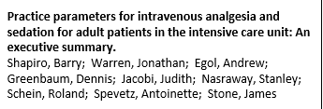
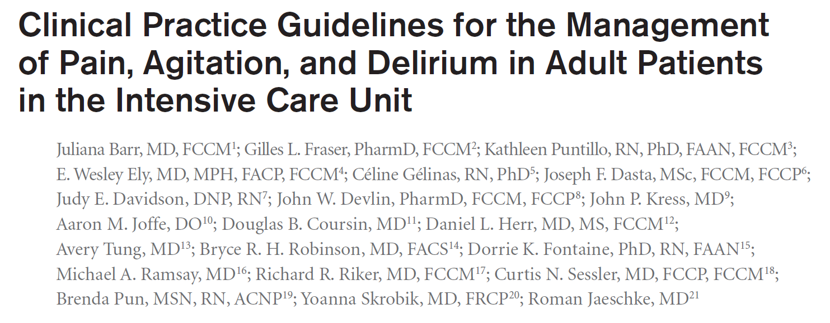
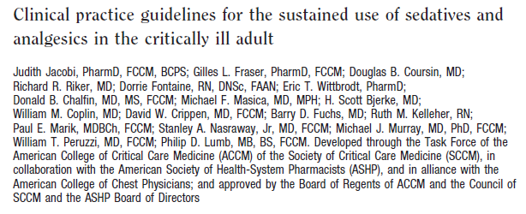
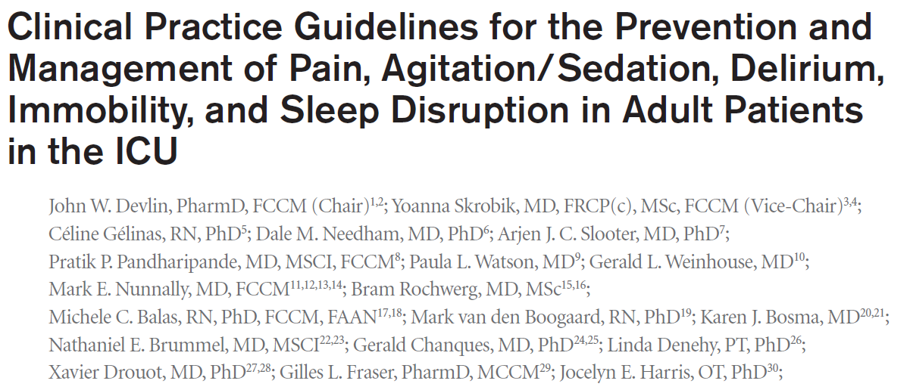
The Path to PADIS
2002
2013
2018
1995
6 recommendations
123 references
36 recommendations
472 references
28 recommendations
235 references
36 recommendations
538 references
Crit Care Med 1995; 23: 1596–600., Crit Care Med 2002;30:119-141., Crit Care Med. 2013;41:263-308. Crit Care Med 2018;46:e-825-e-873.

Slide 6
2018 PADIS Guideline
Partial Update to 2013 PAD guideline
32 members
4 ICU survivors
36 recommendations (2 strong, 34 conditional)
32 ungraded, non-actionable statements
Literature review ended October 2015
Crit Care Med 2018;46:e-825-e-873.

Slide 7
Strong vs. Conditional Recommendation
 | Strong | Conditional
Patients | Applies to almost all patients | Applies to most patients
Supporting evidence | Moderate to high-quality data across broad patient populations | Conflicting, low quality, insufficient, and/or limited patient populations
Benefits vs burdens | Benefits clearly outweigh burdens | close balance between benefits and burdens
Influence of future research | Limited potential to change recommendation | Possible/probable potential to change recommendation
Performance or quality indicators | Can be readily adapted in most healthcare systems | Requires significant deliberation at the local level based on practice patterns, patients served and resource availability
Crit Care Med 2018; 46:1464–1470.

Slide 8
P
Pain
A
Agitation/sedation
D
Delirium
I
Immobility
S
Sleep disruption

Slide 9
P
Pain
15 conditional recommendations
2 strong recommendations
1 good practice statement

Slide 10
Pain
Management of pain for adult ICU patients should be guided by routine pain assessment and pain should be treated before a sedative agent is considered (Good practice statement)
We suggest using an assessment-driven, protocol based, stepwise approach for pain and sedation management in critically ill adults.
Crit Care Med 2018; 46:1464–1470.
Notes:
The rest of the recommendations pertain to multi-modal analgesia and opioid sparing agents/techniques

Slide 11
Agitation/sedation
A
3 conditional recommendations

Slide 12
Agitation/sedation
We suggest using light sedation (vs deep sedation) in critically ill, mechanically ventilated adults.
RASS +1 to -2
Crit Care Med 2018; 46:1464–1470.
Notes:
no consensus on the definition of light, moderate, and deep sedation is available.

Slide 13
Light vs Deep Sedation
Time (Days) to Extubation (N=590)
Fewer required tracheostomy
No difference in self-extubation
Evidence gaps:
How to define light, moderate, and deep sedation
Effect of light sedation on post-ICU outcomes
Interaction of sedation choice and depth
Crit Care Med 2018; 46:1464–1470.

Slide 14
Agitation/sedation
We suggest using propofol over a benzodiazepine for sedation in mechanically ventilated adults after cardiac surgery.
We suggest using either propofol or dexmedetomidine over benzodiazepines for sedation in critically ill, mechanically ventilated adults.
Crit Care Med 2018; 46:1464–1470.

Slide 15
Propofol vs Dexmedetomidine
Duration of Mechanical Ventilation in RCTs (N=850)
PRODEX- dexmedetomidine less delirium 48 hours post sedation
No differences in hypotension or bradycardia
“Desirable and undesirable consequences were balanced”
Crit Care Med 2018;46:e-825-e-873.

Slide 16
Delirium
D
6 conditional recommendations
1 good practice statement

Slide 17
Delirium
Critically ill adults should be regularly assessed for delirium using a valid tool (Good Practice Statement)
We suggest not using haloperidol, an atypical antipsychotic, dexmedetomidine, a HMG-CoA reductase inhibitor (i.e., statin), or ketamine to prevent delirium in all critically ill adults.
Crit Care Med 2018;46:e-825-e-873.

Slide 18
Delirium Pharmacologic Treatment
We suggest not using haloperidol or an atypical antipsychotic to treat subsyndromal delirium in critically ill adults.
We suggest not routinely using haloperidol, an atypical antipsychotic, or a HMG-CoA reductase inhibitor (i.e.,a statin) to treat delirium.
We suggest using dexmedetomidine for delirium in mechanically ventilated adults where agitation is precluding weaning/extubation.
Crit Care Med 2018;46:e-825-e-873.

Slide 19
Dexmedetomidine for Agitated Delirium in Mechanically Ventilated Patients (DahLIA)
 | DahLIA, 2016
Design: | Multicenter, randomized, double-blind, parallel-group, placebo-controlled trial
Intervention: | Dexmedetomidine IV infusion or placebo for up to 7 days
Outcomes: | Ventilator-free hours in the first 7 days from randomization
Patients: | 71 patients unable to be extubated only due to agitated delirium per MD
Results: | Shorter time to extubation Decreased delirium with dexmedetomidine No difference in ICU of hospital LOS
Critique: | Stopped early due to funding Screened 21,500 patients to enroll 71 patients
Ventilator-free Hours
p=0.04
JAMA. 2016;315(14):1460-1468.

Slide 20
Delirium
We suggest using a multicomponent, nonpharmacologic intervention that is focused on (but not limited to) reducing modifiable risk factors for delirium, improving cognition, and optimizing sleep, mobility, hearing, and vision in critically ill adults.
Evidence gaps:
Pharmacologic prevention studies in severely ill medical patients
Subsyndromal delirium’s significance, characteristics, and measurement
Treatment studies in homogeneous high risk populations
System innovations to prevent discharge on medications including anti-psychotics
Role of families in prevention and treatment
Crit Care Med 2018;46:e-825-e-873.

Slide 21
Immobility
I
1 conditional recommendation

Slide 22
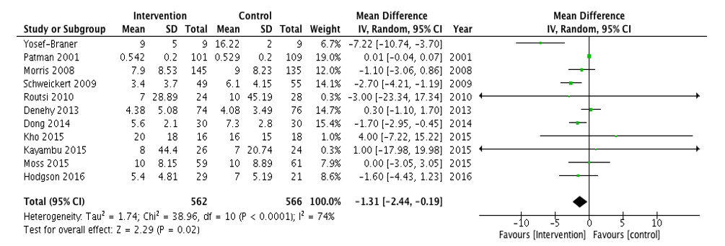
Immobility (mobilization/rehabilitation)
We suggest performing rehabilitation or mobilization in critically ill adults
Duration (Days) of Mechanical Ventilation 11 RCTs, (N=1,128)
Increased muscle strength
Decreased delirium days
Crit Care Med 2018;46:e-825-e-873.

Slide 23
Sleep disruption
6 conditional recommendations
S

Slide 24
Sleep disruption
We suggest not routinely using physiologic sleep monitoring clinically in critically ill adults.
We suggest not using aromatherapy, acupressure, or music at night to improve sleep in critically ill adults
We suggest using noise and light reduction strategies to improve sleep in critically ill adults.
Crit Care Med 2018;46:e-825-e-873.

Slide 25
Sleep-promoting Protocols
We suggest using a sleep-promoting, multicomponent protocol in critically ill adults.
Delirium Incidence (N=359)
No difference seen in daytime sleepiness
Crit Care Med 2018;46:e-825-e-873.
Notes:
Shown to improve delirium even though not shown to improve sleep

Slide 26
Sleep disruption
We suggest not using propofol to improve sleep in critically ill adults.
REM suppression
We make no recommendation regarding the use of melatonin to improve sleep in critically ill adults.
Limited data
Not FDA regulated
We make no recommendation regarding the use of dexmedetomidine at night to improve sleep.
Crit Care Med 2018;46:e-825-e-873.
Notes:
Dexmed decreases stage 1 (light sleep) and increases stage 2 moderate depth sleep

Slide 27
Nocturnal Dexmedetomidine
 | Skrobik, 2018
Design: | 2 center, randomized, double-blind, placebo-controlled trial
Intervention: | Dexmedetomidine 0.2 to 0.7 mcg/kg/hr IV infusion or placebo from 2130 to 0615 until ICU discharge
Outcomes: | % of patients delirium free throughout ICU admission
Patients: | 100 delirium free patients Intermittent or continuous sedatives > 48 hour ICU stay expected
Results: | Decreased delirium days No difference in sleep quality Decreased delirium incidence No difference in ICU of hospital LOS
Critique: | Patient reported survey to assess sleep Halved sedation when nocturnal therapy started 74% of patients were excluded
Delirium-free ICU Stay
p=0.006
Am J Respir Crit Care Med. 2018;197,(9):1147–1156.

Slide 28
Interpreting an Implementing PADIS
Crit Care Med 2018; 46:1464–1470.

Slide 29
ICU Liberation Collaborative
8% Total Bundle Performance
Crit Care Med 2019; 47:3–14.
Notes:
Data 68 centers who were part of the collaborative

Slide 30
2018 (Pain Agitation/sedation Delirium Immobility and Sleep disruption) PADIS guideline
John Hammer, PharmD, MBA, BCPS, DPLA
John.Hammer@atriumhealth.org

