Slide 1
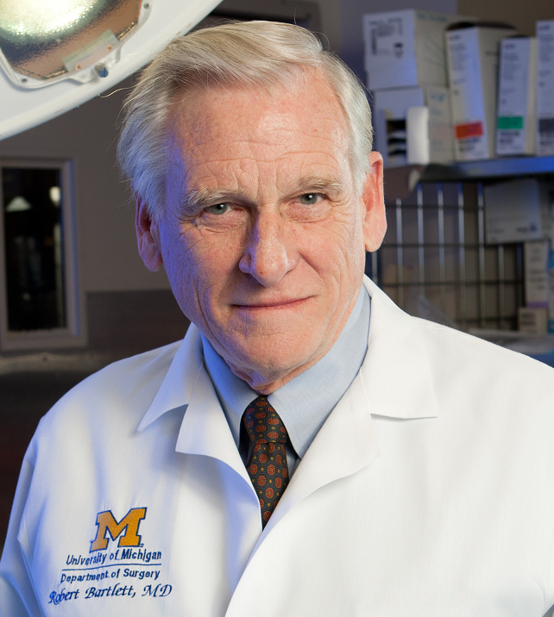
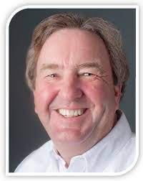
September 9th, 2023
SCCM MIDWEST CHAPTER PRESENTS:
4th ANNUAL CRITICAL CARE CONFERENCE Venue: Advocate Christ Medical Center, Oak Lawn, IL
8:00 am -8:15 am: Registration and Exhibit Hall
8:15 am - 8:30 am: President's Address
Welcome, Introduction, Housekeeping Remarks Varsha Gharpure, MD, FAAP, FCCM
8:35 am - 9:20 am: Plenary Session
From ECMO to Ex Vivo Organ Perfusion! Robert Bartlett, MD
9:25 am - 10:10 am: Keynote Address
Mitochondrial Transplantation: A New Model for Organ Rescue! James McCully, PhD
10:10 am - 10:25 am: Coffee Break / Exhibit Hall
10:25 am - 11:25 am: Breakout Sessions (Select one)*
ECMO Simulation: Kristen Nelson-McMillan, MD Leon Eydelman, MD
Continuous Renal Replacement Therapies: Simulation Priya Chandra, MD Erin Kim, MD
Mechanical Ventilation: Patient-Ventilator Asynchrony Robert Chatburn, MHHS, RRT-NPS, FAARC Varsha Gharpure, MD
Neuro Critical Care: The Who, What, and Why of Aneurysmal Subarachnoid Hemorrhage Andrea Sterenstein, MD
11:35 am - 12:20 pm: Research Presentations
12:20 pm – 1:20 pm: Lunch / Exhibit Hall
FEATURED SPEAKERS
Dr. Robert Bartlett
Dr. James McCully

Slide 2
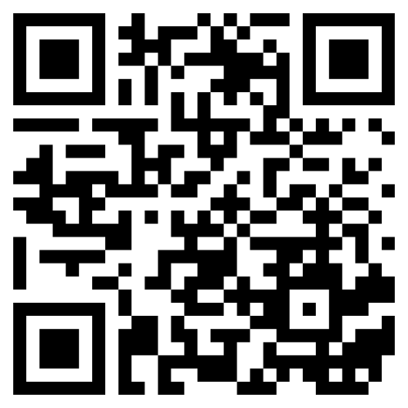
September 9th, 2023
SCCM MIDWEST CHAPTER PRESENTS:
4th ANNUAL CRITICAL CARE CONFERENCE Venue: Advocate Christ Medical Center, Oak lawn, IL
1:25 to 2:25 pm: Pharmacy Lecture ICU Delirium: The Deceptively Simple Majdi Hamarshi, MD
Let it Snow or Let it Go? Sedation and Analgesia in the ICU
Veronica Bonderski, PharmD, BCCCP
2:30 pm - 3:00 pm: Star Research Presentations
3:00 pm - 3:15 pm: Coffee Break / Exhibit Hall
3:20 pm - 4:20 pm: Breakout Sessions (Repeat from morning) (Select one)*
4:20 pm - 5:05 pm: Jeopardy: Moderator Padmaraj Duvvuri, MD, MS
5:05 pm - 5:15 pm: Closing Remarks: Candice White, MSN, APRN, AGCNS-BC *Space is limited for Simulation Sessions. Register early to secure your spot.
This program will provide 6 hours of CME/CEU per University of Illinois College of Medicine at Peoria (Subject to approval).
To Register: Scan QR Code
Or Visit: https://www.sccmmwc.org/event-registration/ Registration Fees: SCCM Midwest Chapter members: Physicians: $60, Non-physicians/Trainees: $20 Non-Members: Physicians: $100, Non-physicians/Trainees: $60 Speakers/Sponsors/Jeopardy Participants: $0
To Join SCCM Midwest Chapter Click:
https://www.sccm.org/Member-Center/Chapters/Midwest-Chapter (Cost $45, You will need to create an account if you do not have SCCM membership ID. SCCM membership is encouraged but not required to join the chapter) Abstract Submission: Deadline August 10th, 2023. We appreciate support from University of Illinois College of Medicine at Peoria for providing CME credit.

